Slide 1
Nashmia Haroon
Lahore, Pakistan
+92 332 4602986
Nashmya@hotmail.com
Tagheerlahorecs@gmail.com
Marks of Sound ii
It's a dance of colour, form and mark making that dictates the artist to advance on the surface. Making non representational art is about trusting of the subconscious mind, to allow to flow through the body of the artist and onto the canvas.
It may also be considered that the artist is looking for divine intervention at the moment of submission to the medium.
The realization of each of my works is imagined as a portal into seeking purity that is in harmony with all senses. Like a song, a certain balance within the structure of notes is need for it to sound right to the ear.
This body of work is yet another attempt to arrive at this point of harmony and balance.

Slide 2
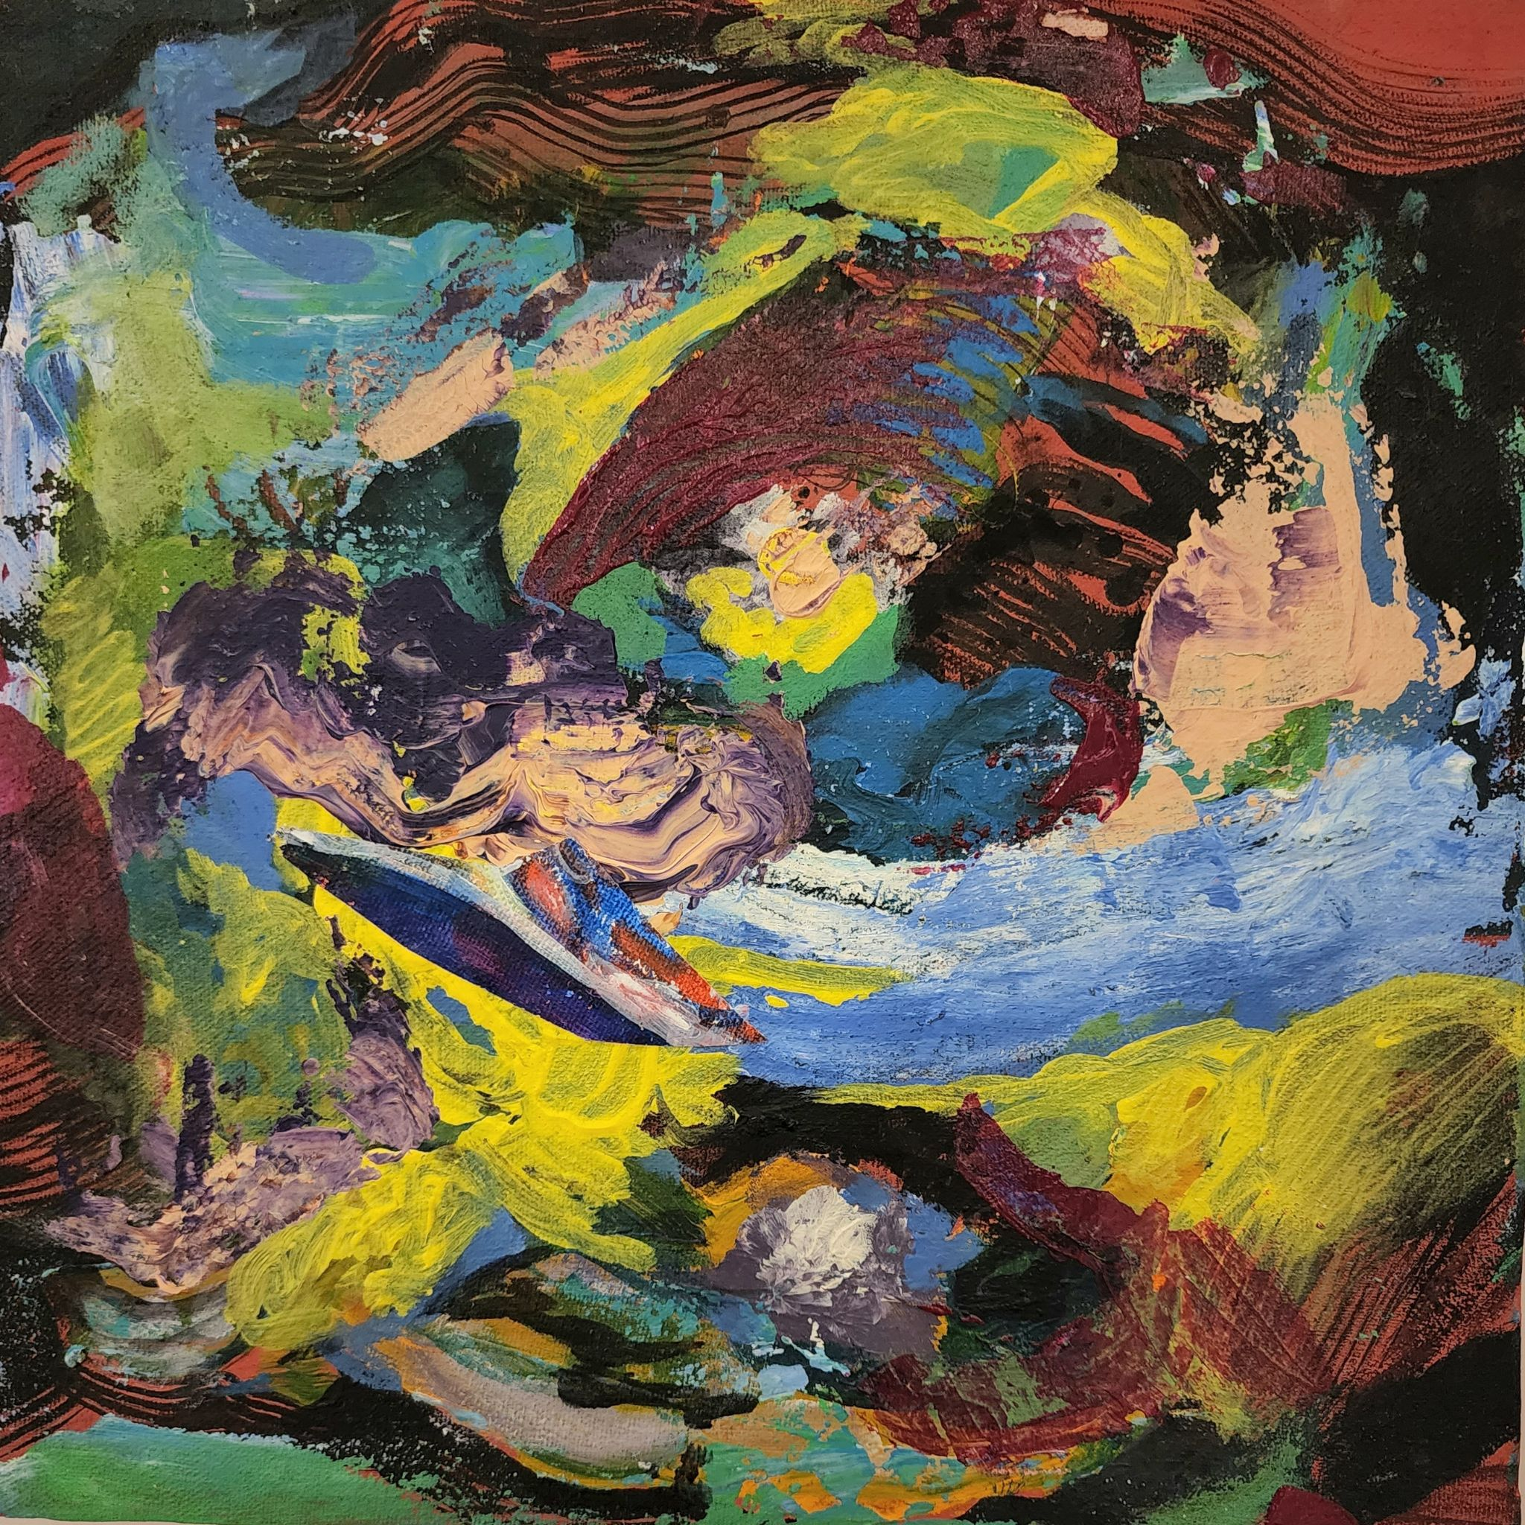
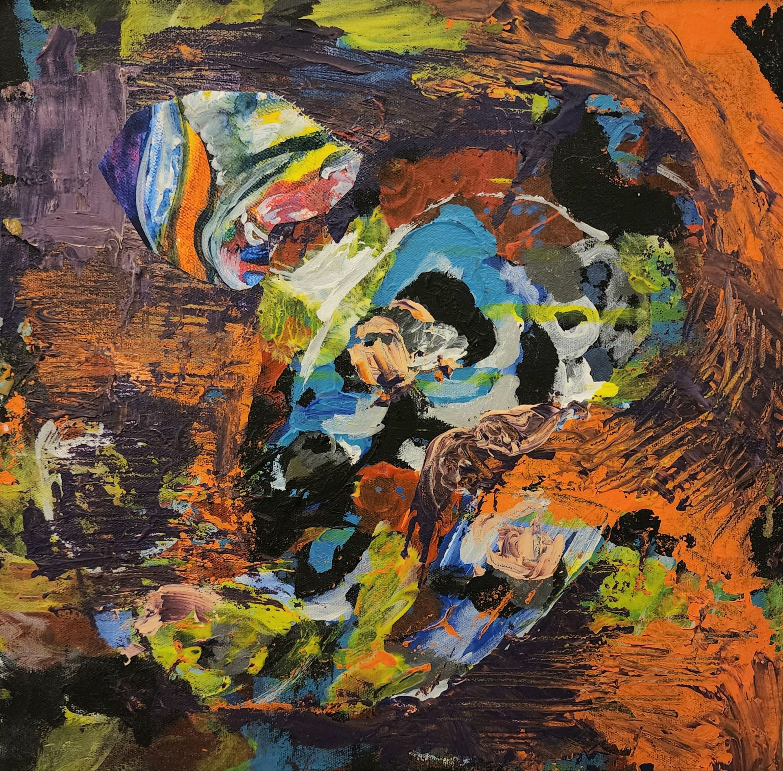
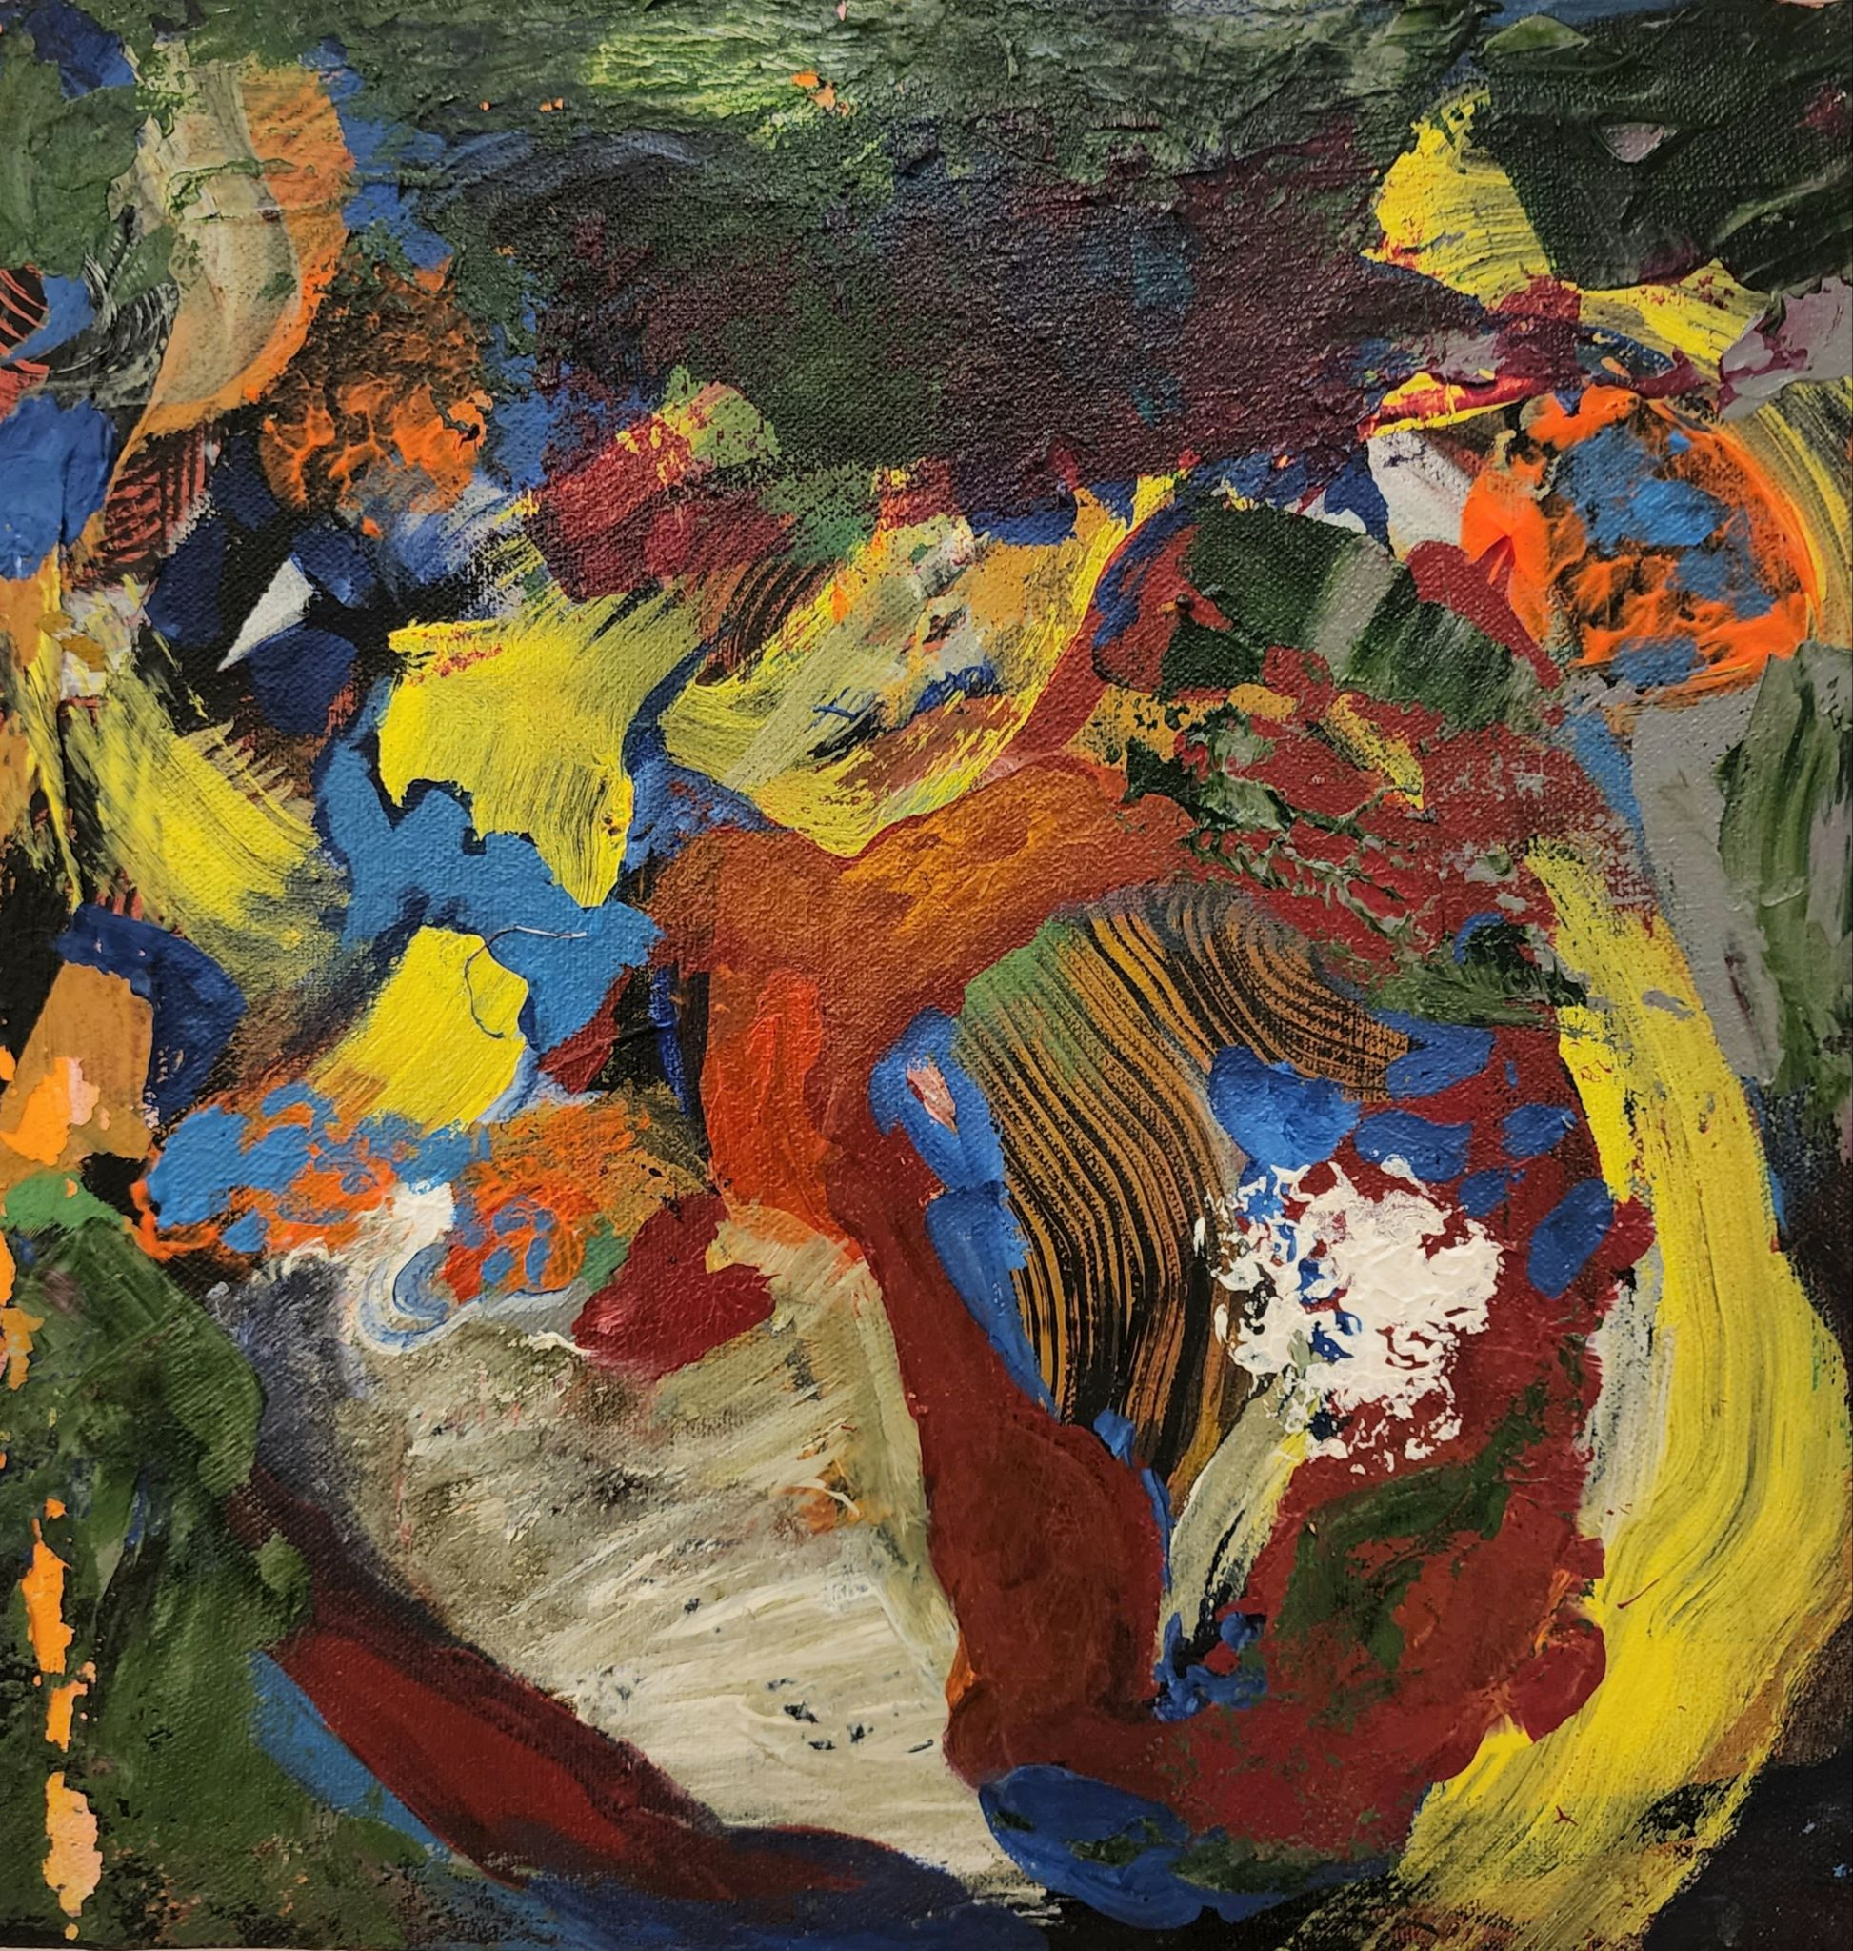
1
1tx1ft (each)
Tryptic
Acrylic on Canvas
2022
Price: Rs. 90,000

Slide 3
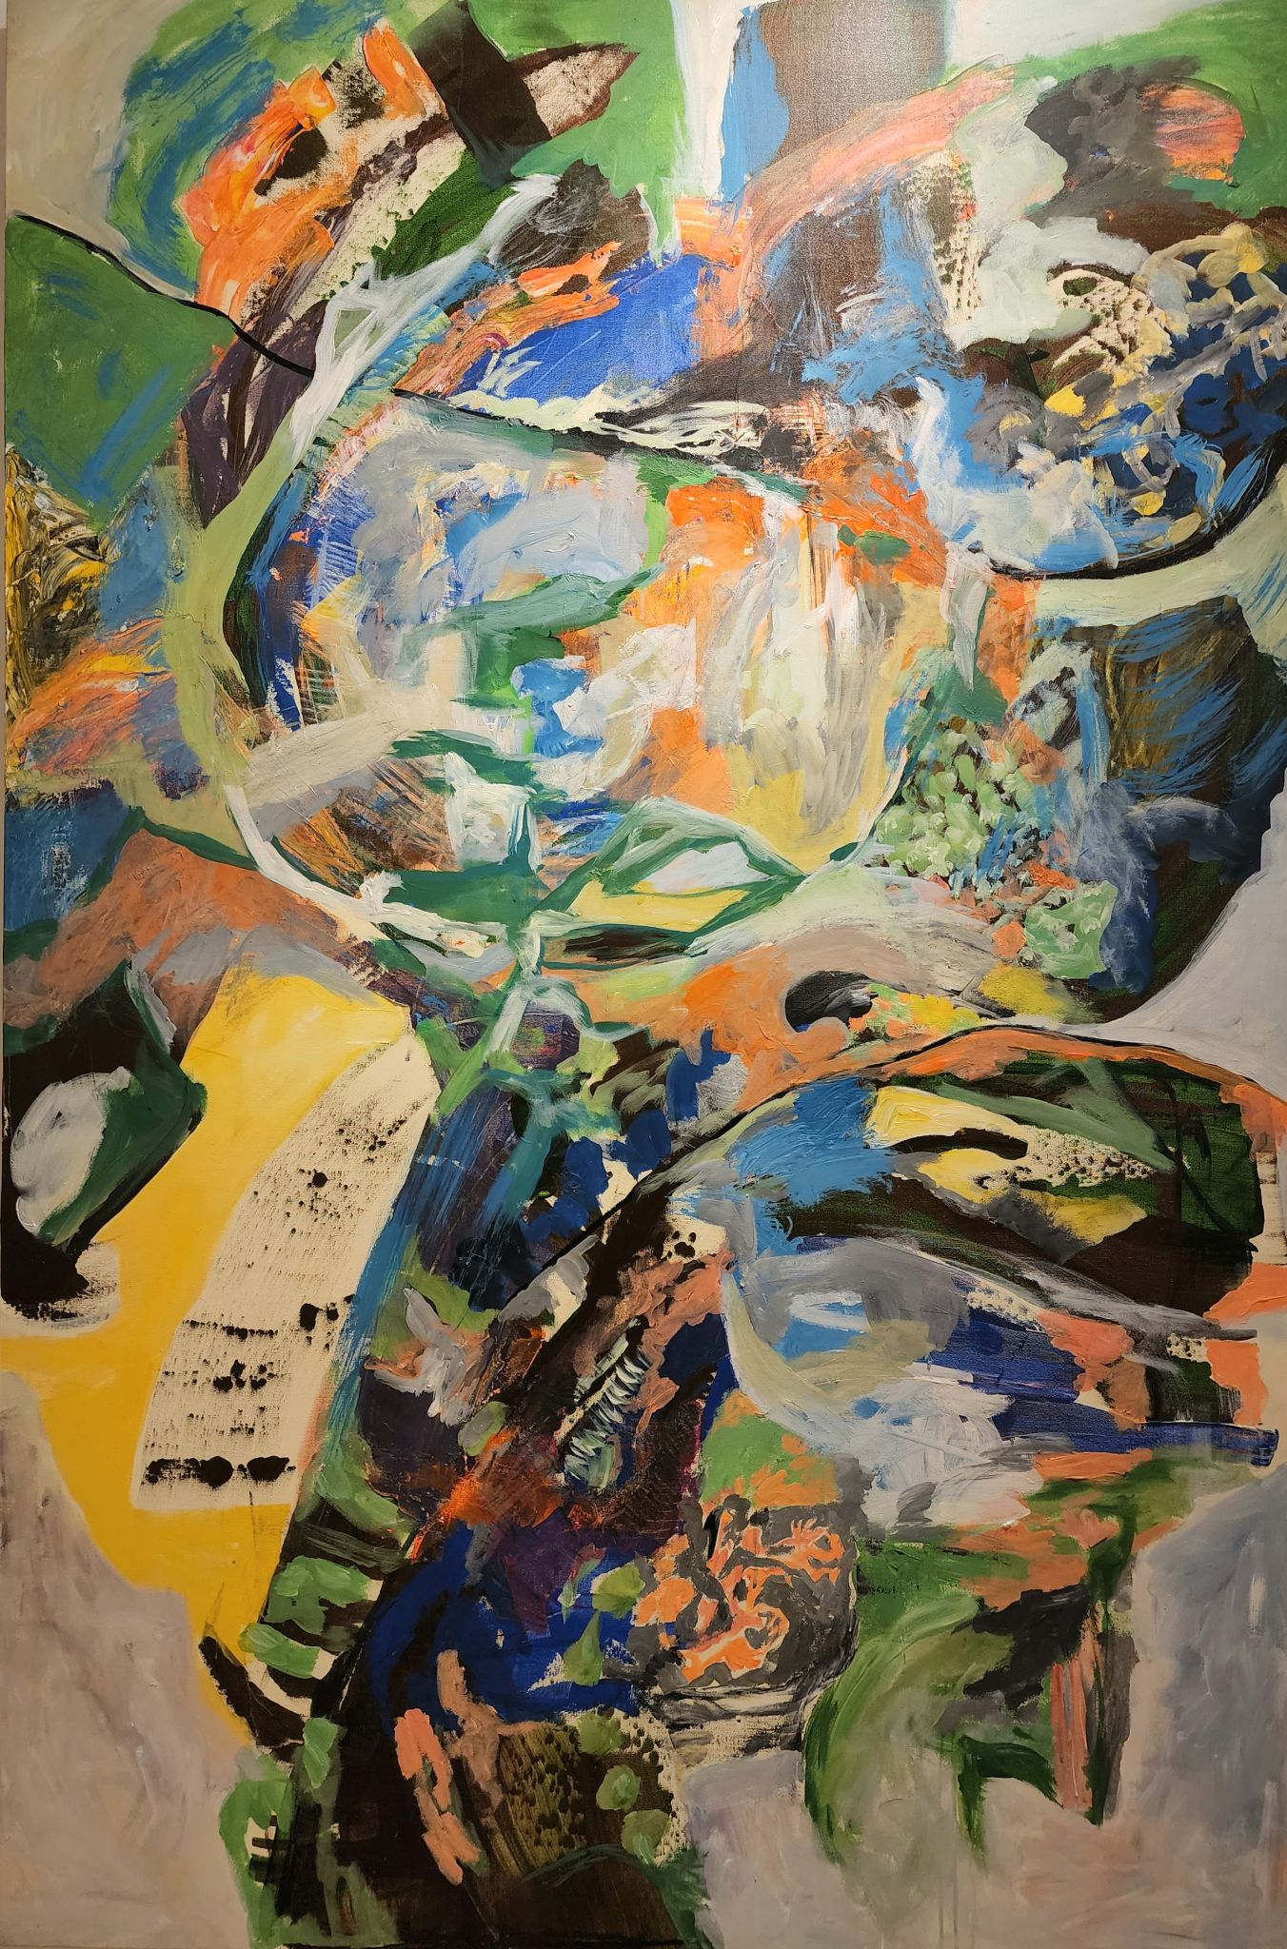
2
6ftx4ft
Acrylic on Canvas
2022
Price: Rs. 220,000

Slide 4
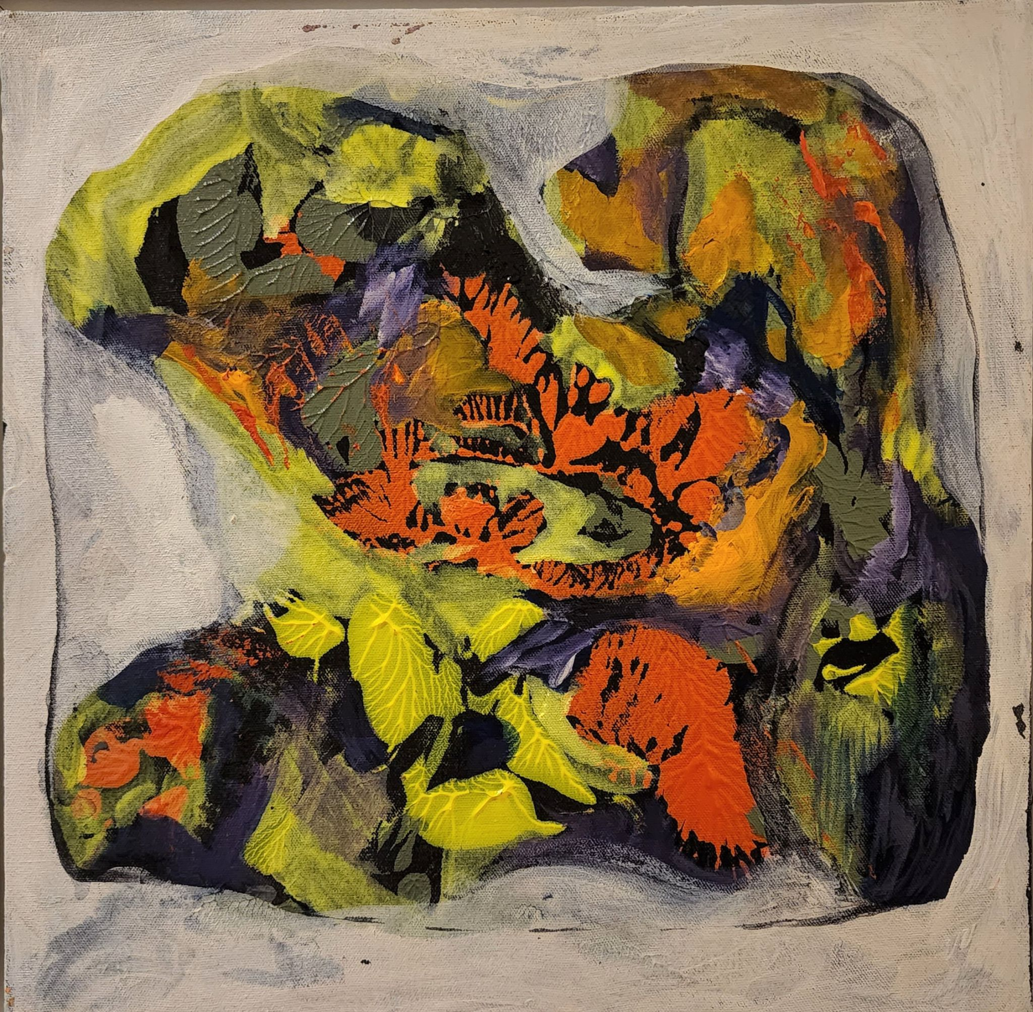
3
13.6”x19”
Acrylic on Canvas
2022
Price: Rs. 45,000

Slide 5
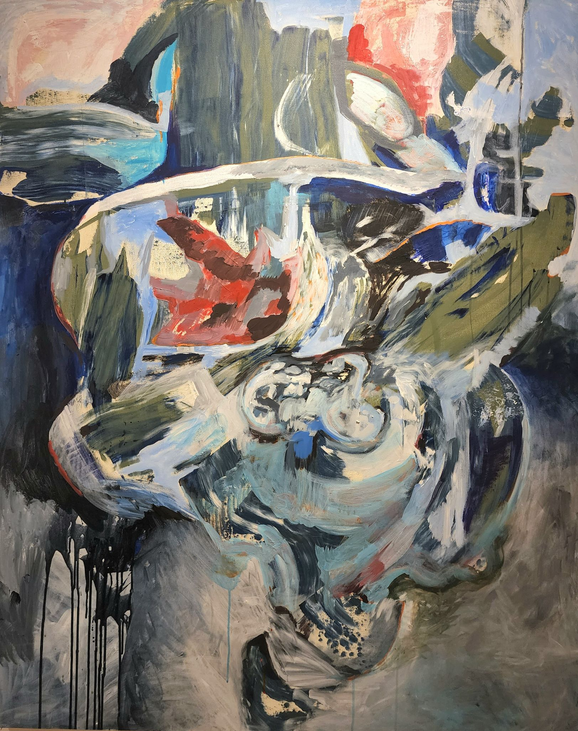
4
5ftx4ft
Acrylic on Canvas
2022
Price: Rs. 195,000

Slide 6
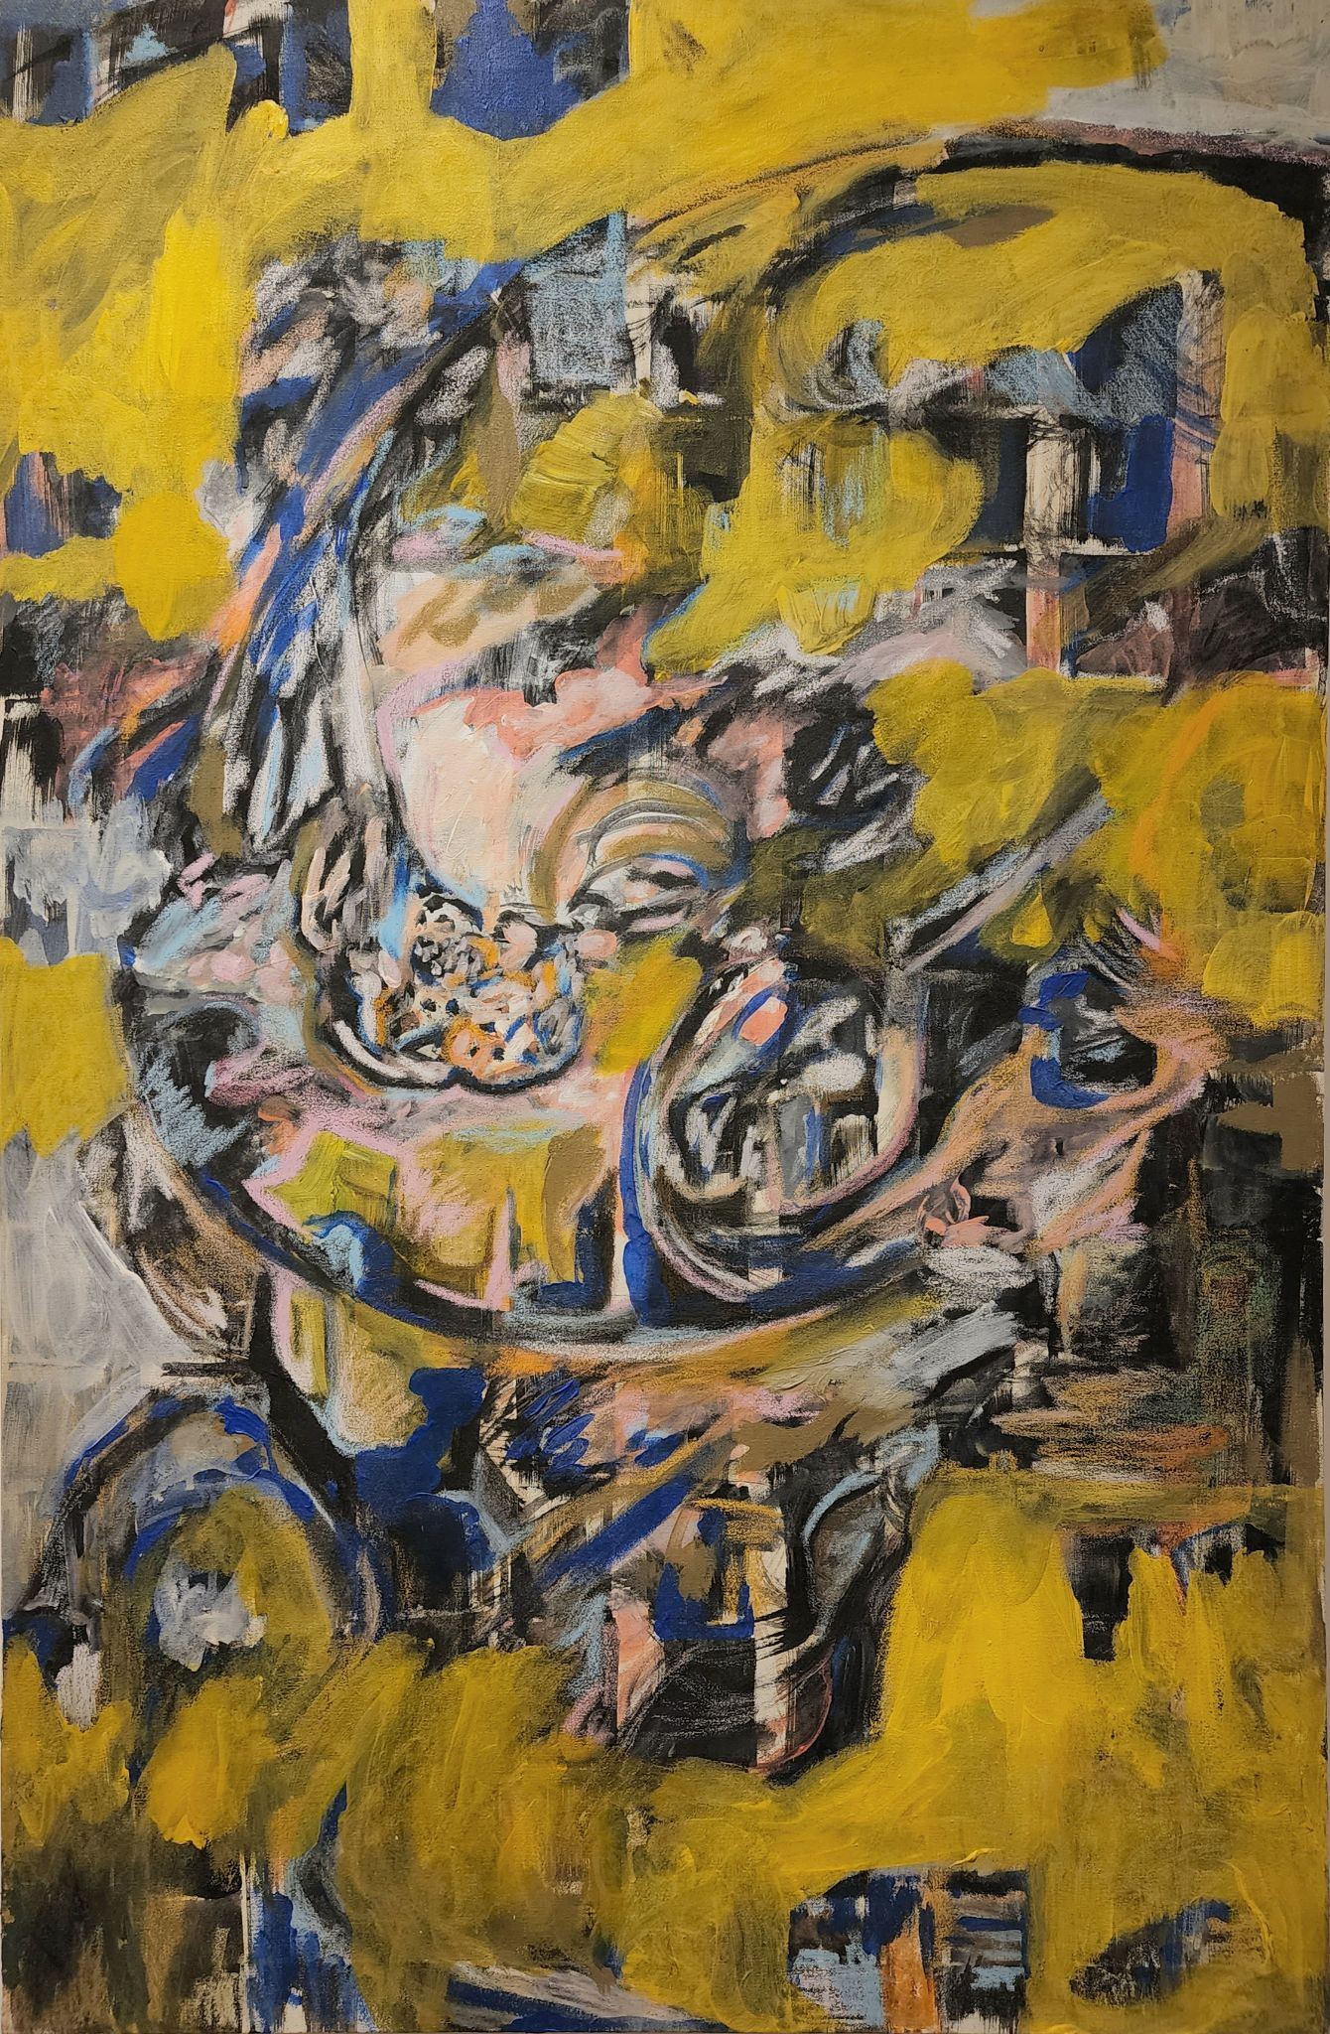
5
3ftx2ft
Acrylic on Canvas
2022
Price: Rs. 145,000

Slide 7
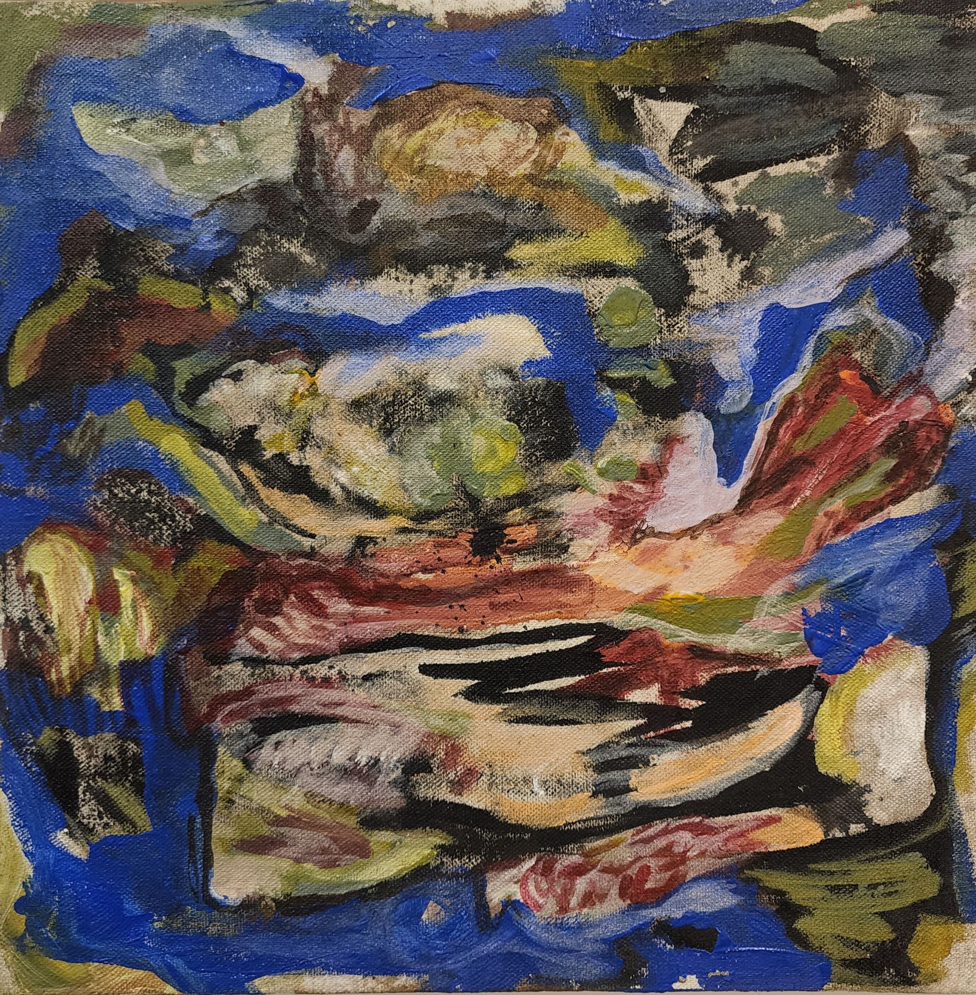
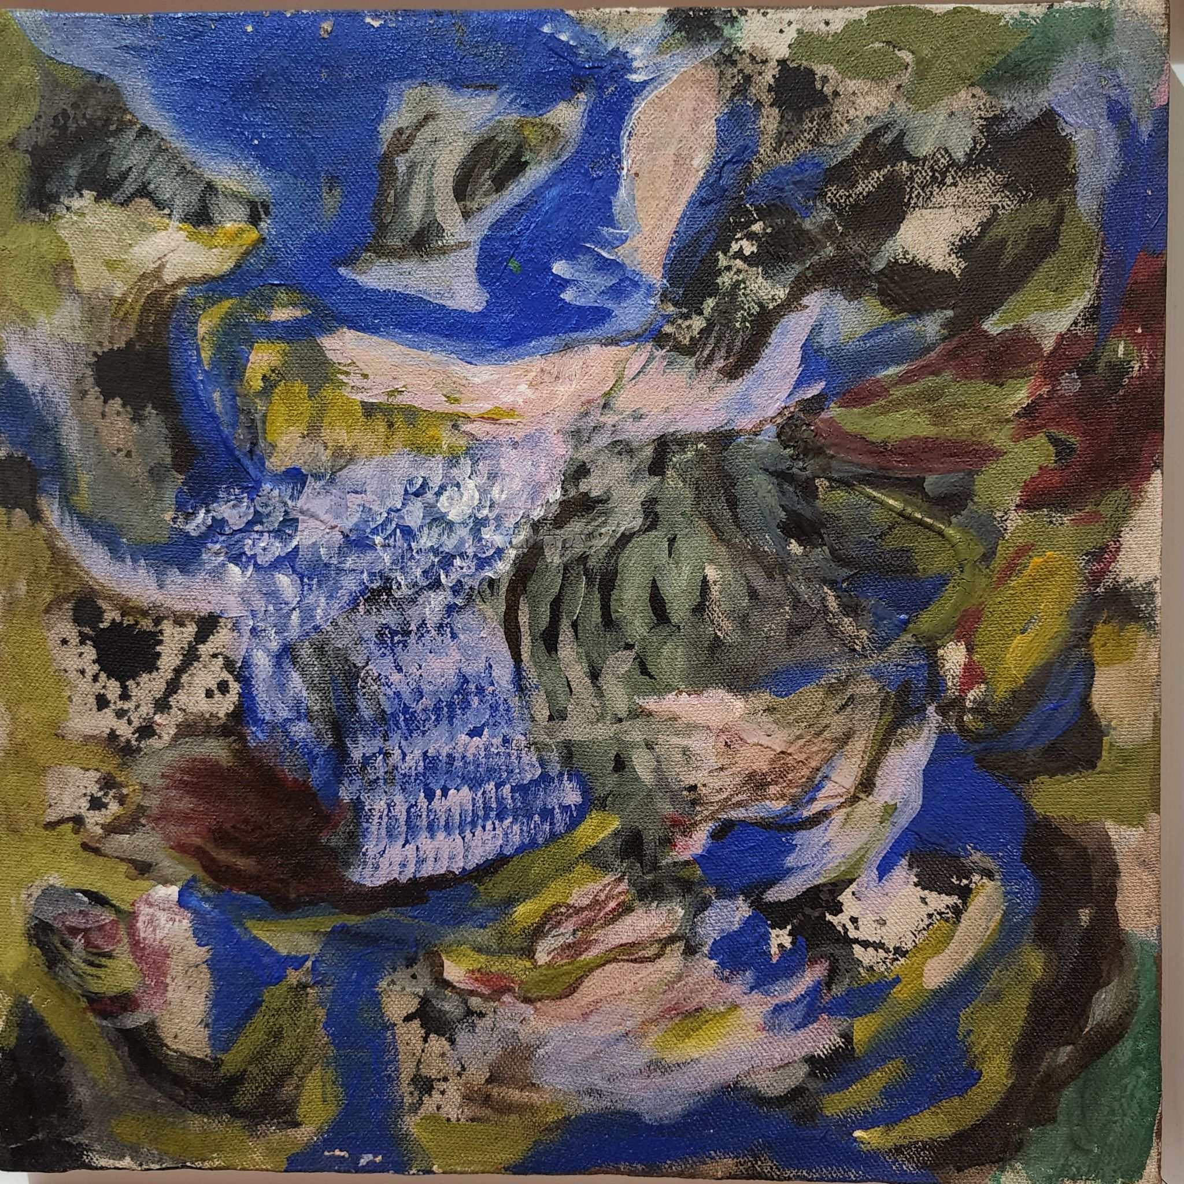
6
1tx1ft (each)
diptych
Acrylic on Canvas
2022
Price: Rs. 75,000

Slide 8
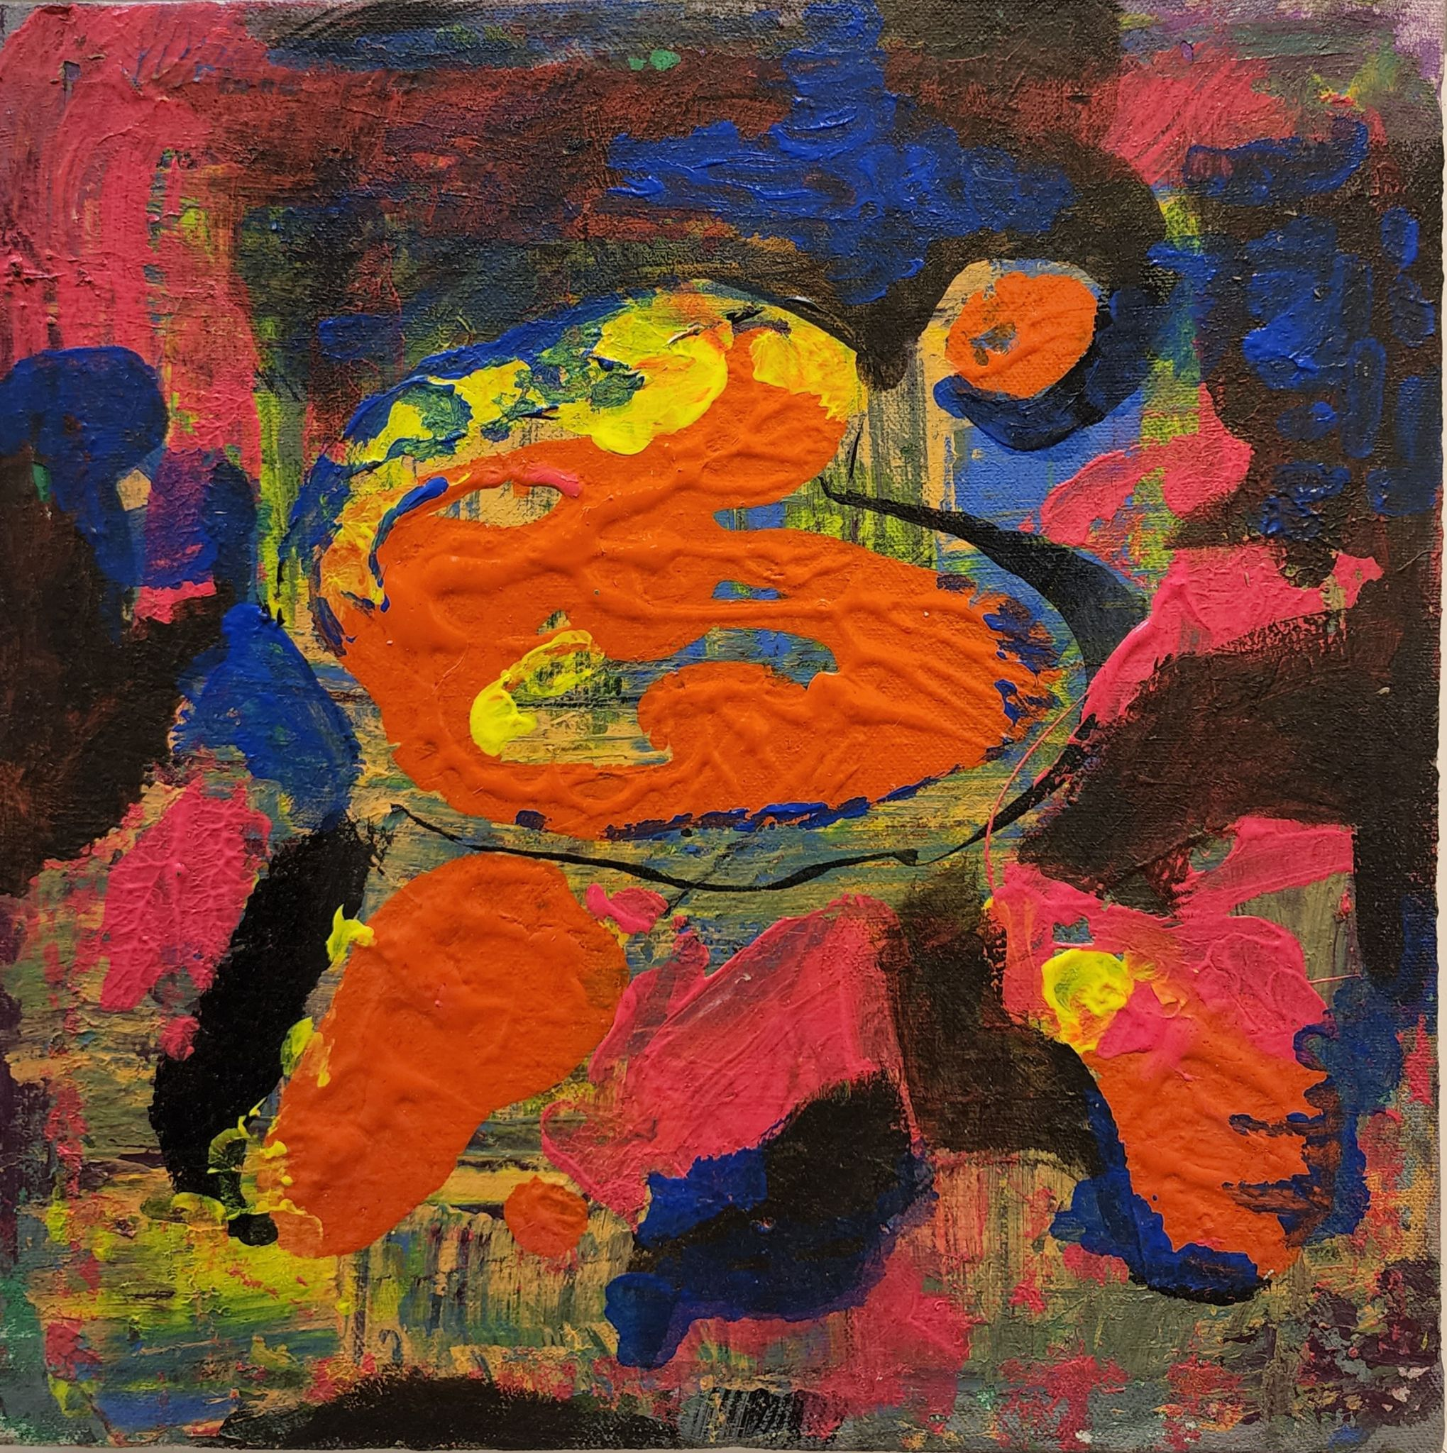
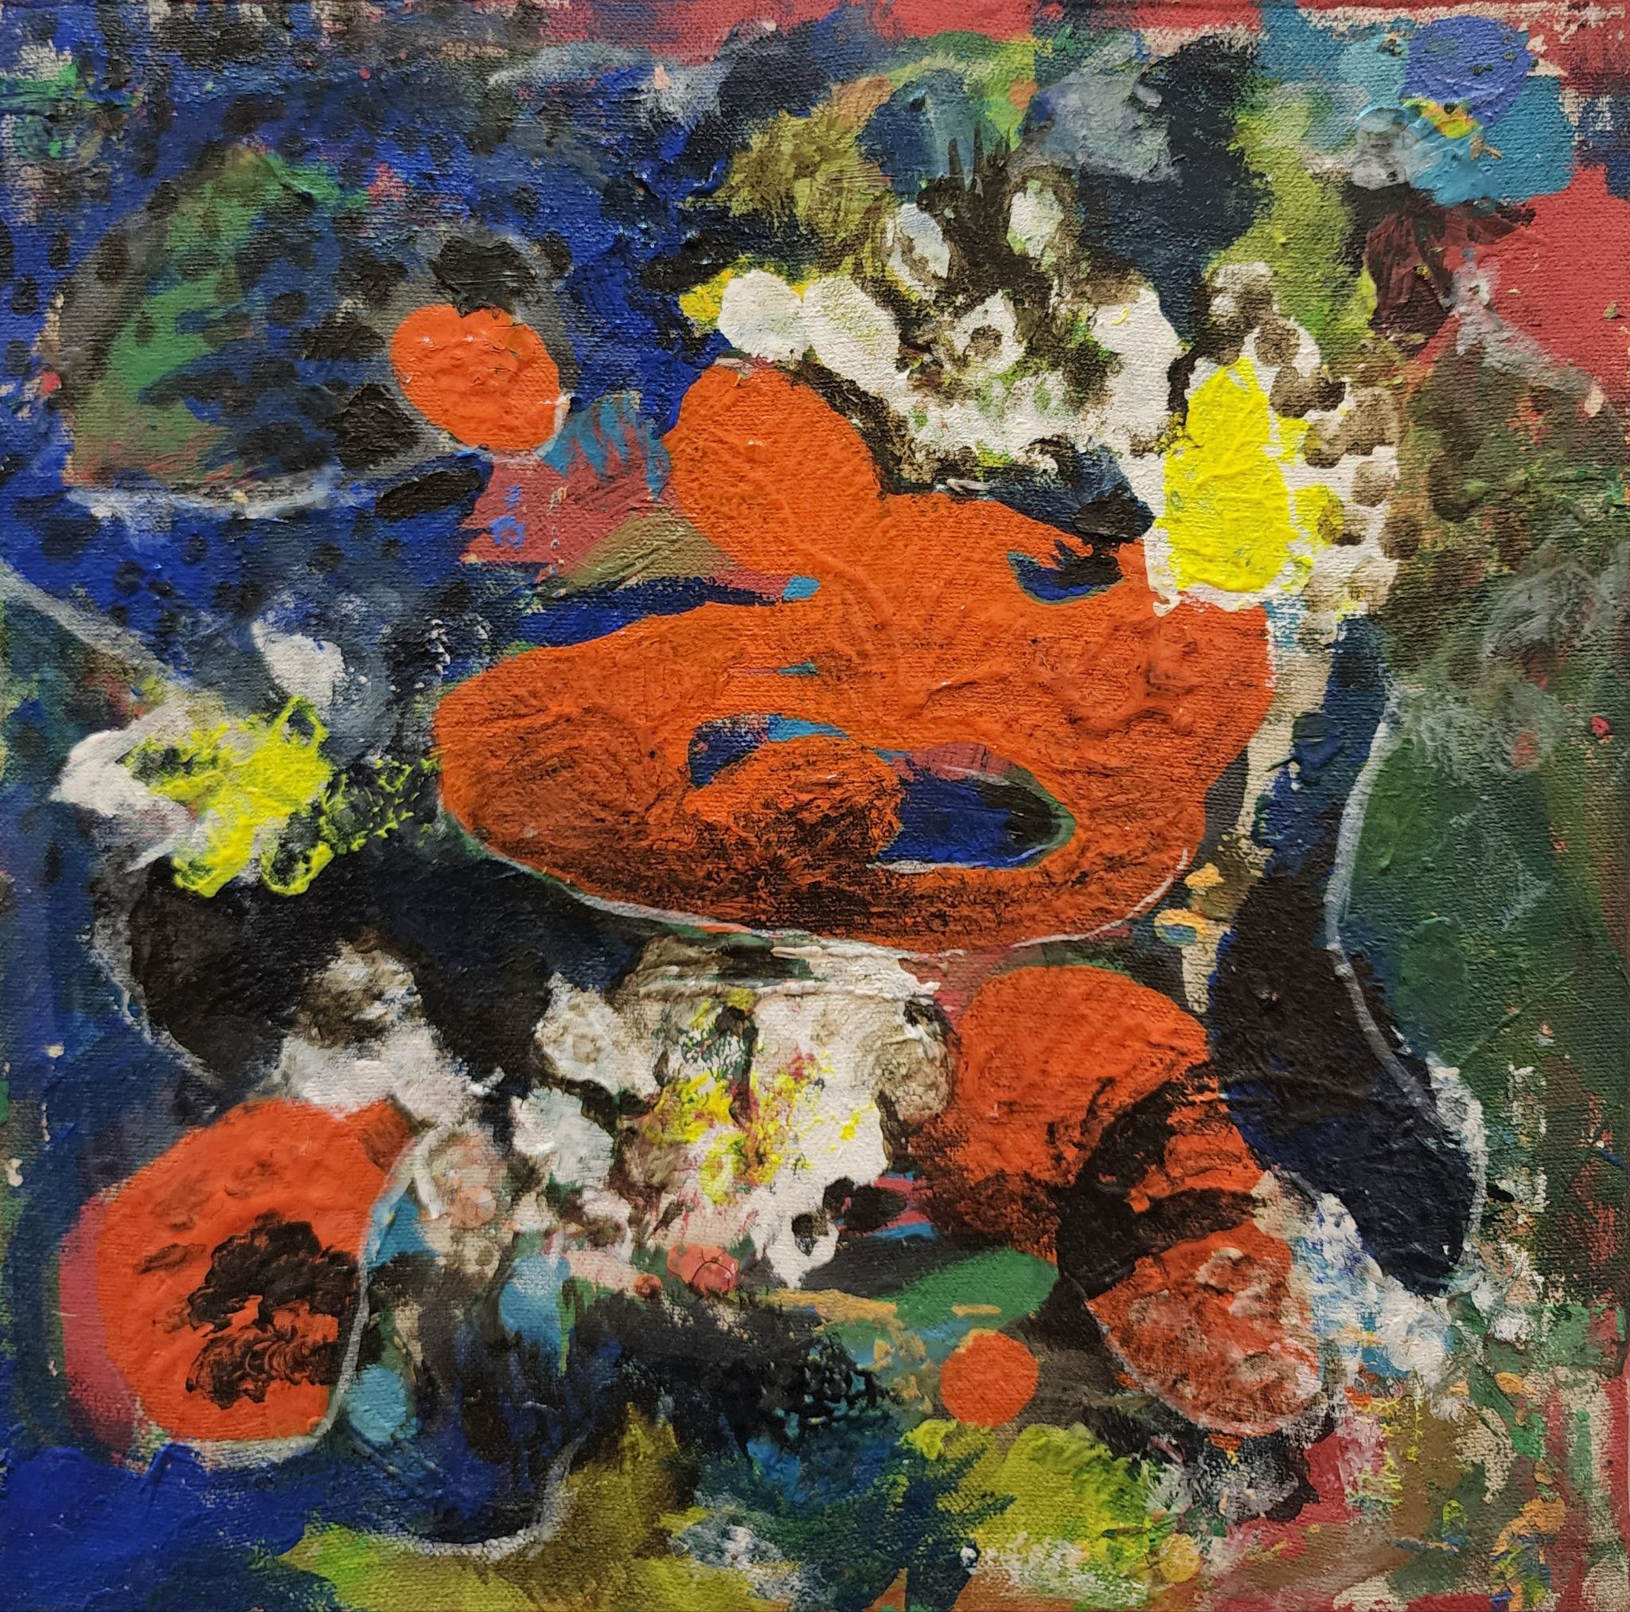
7
1ftx1ft
diptych
Acrylic on Canvas
2022
Price: Rs. 75,000

Slide 9
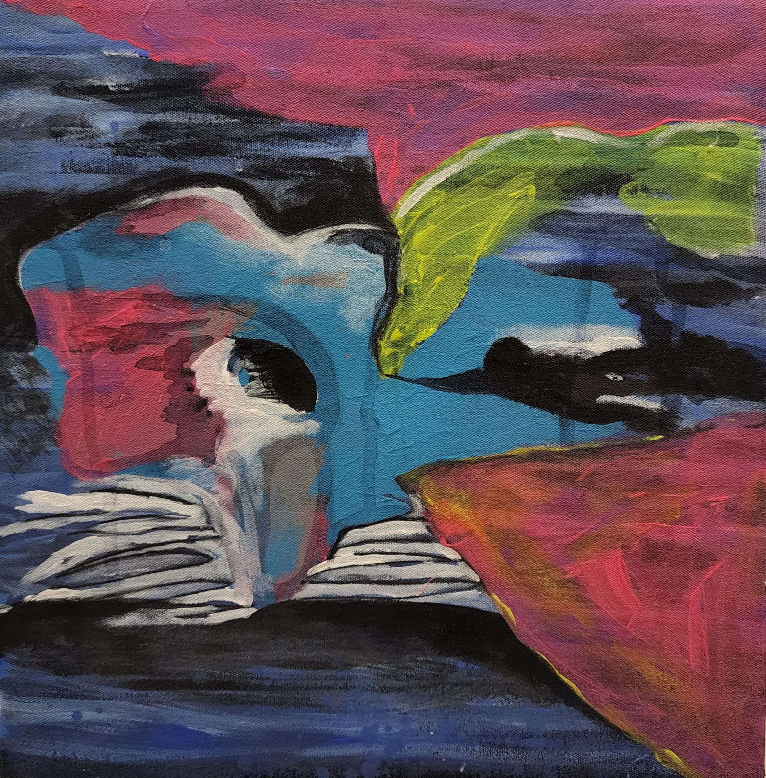
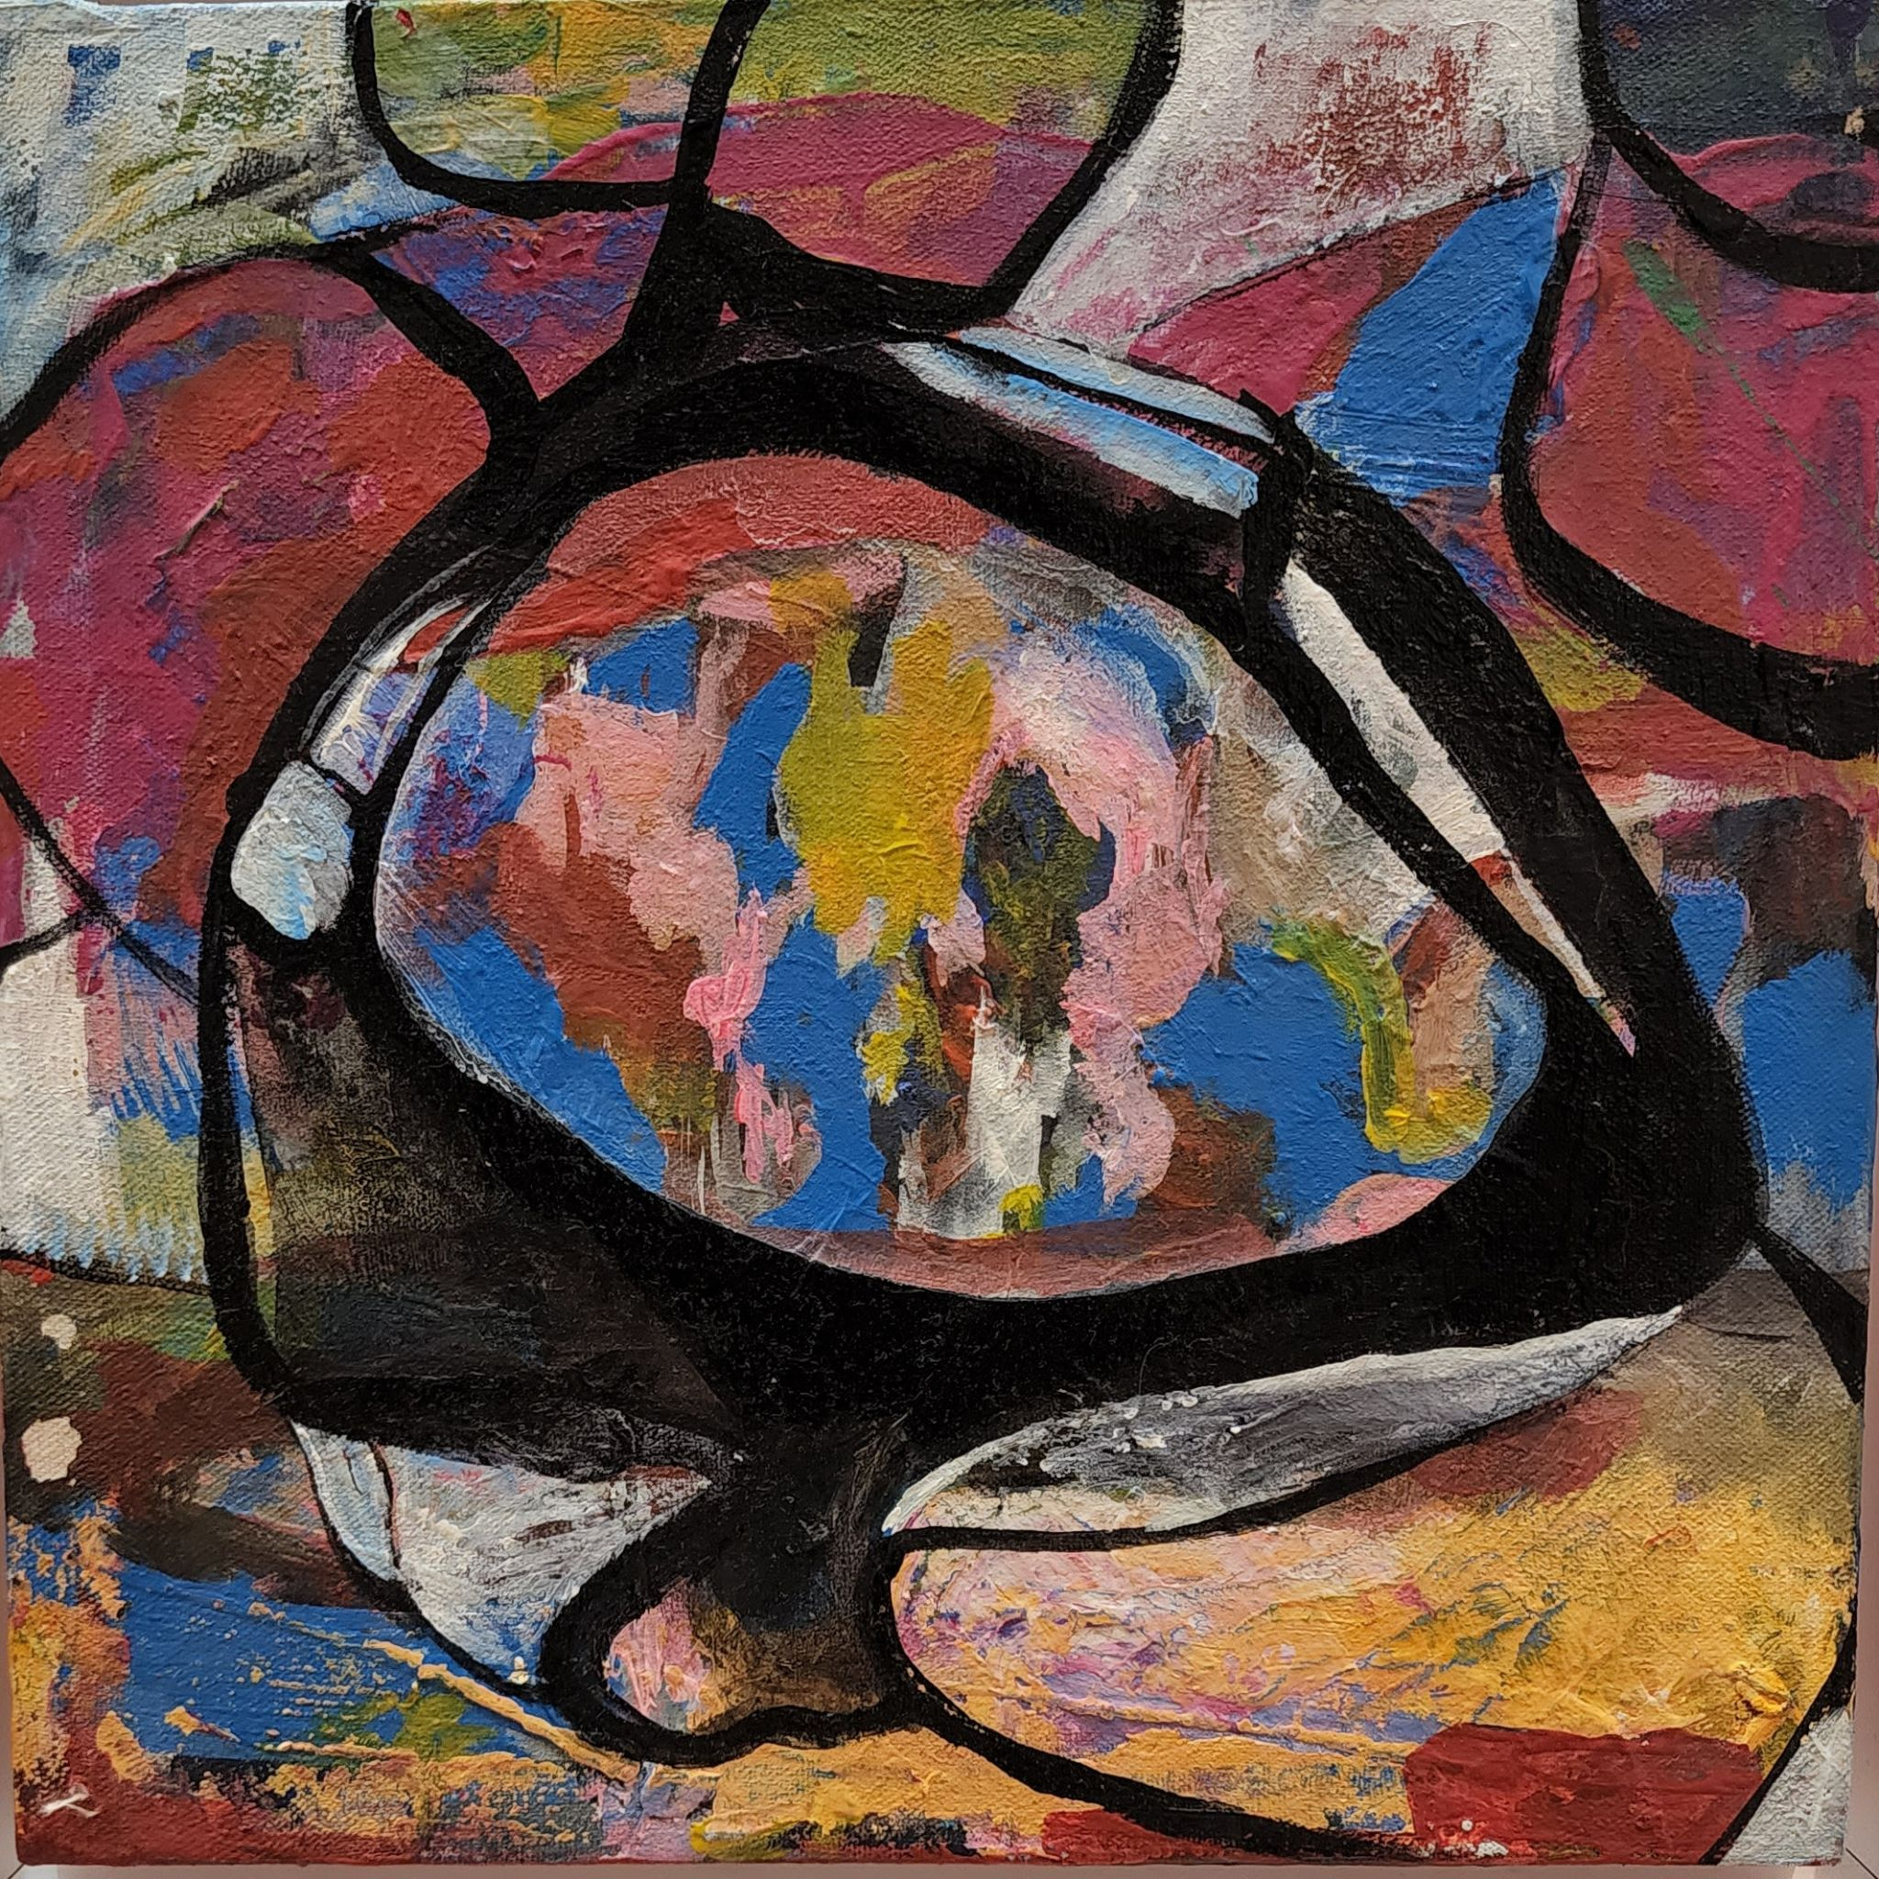
8
1tx1ft (each)
diptych
Acrylic on Canvas
2022
Price: Rs. 75,000

Slide 10
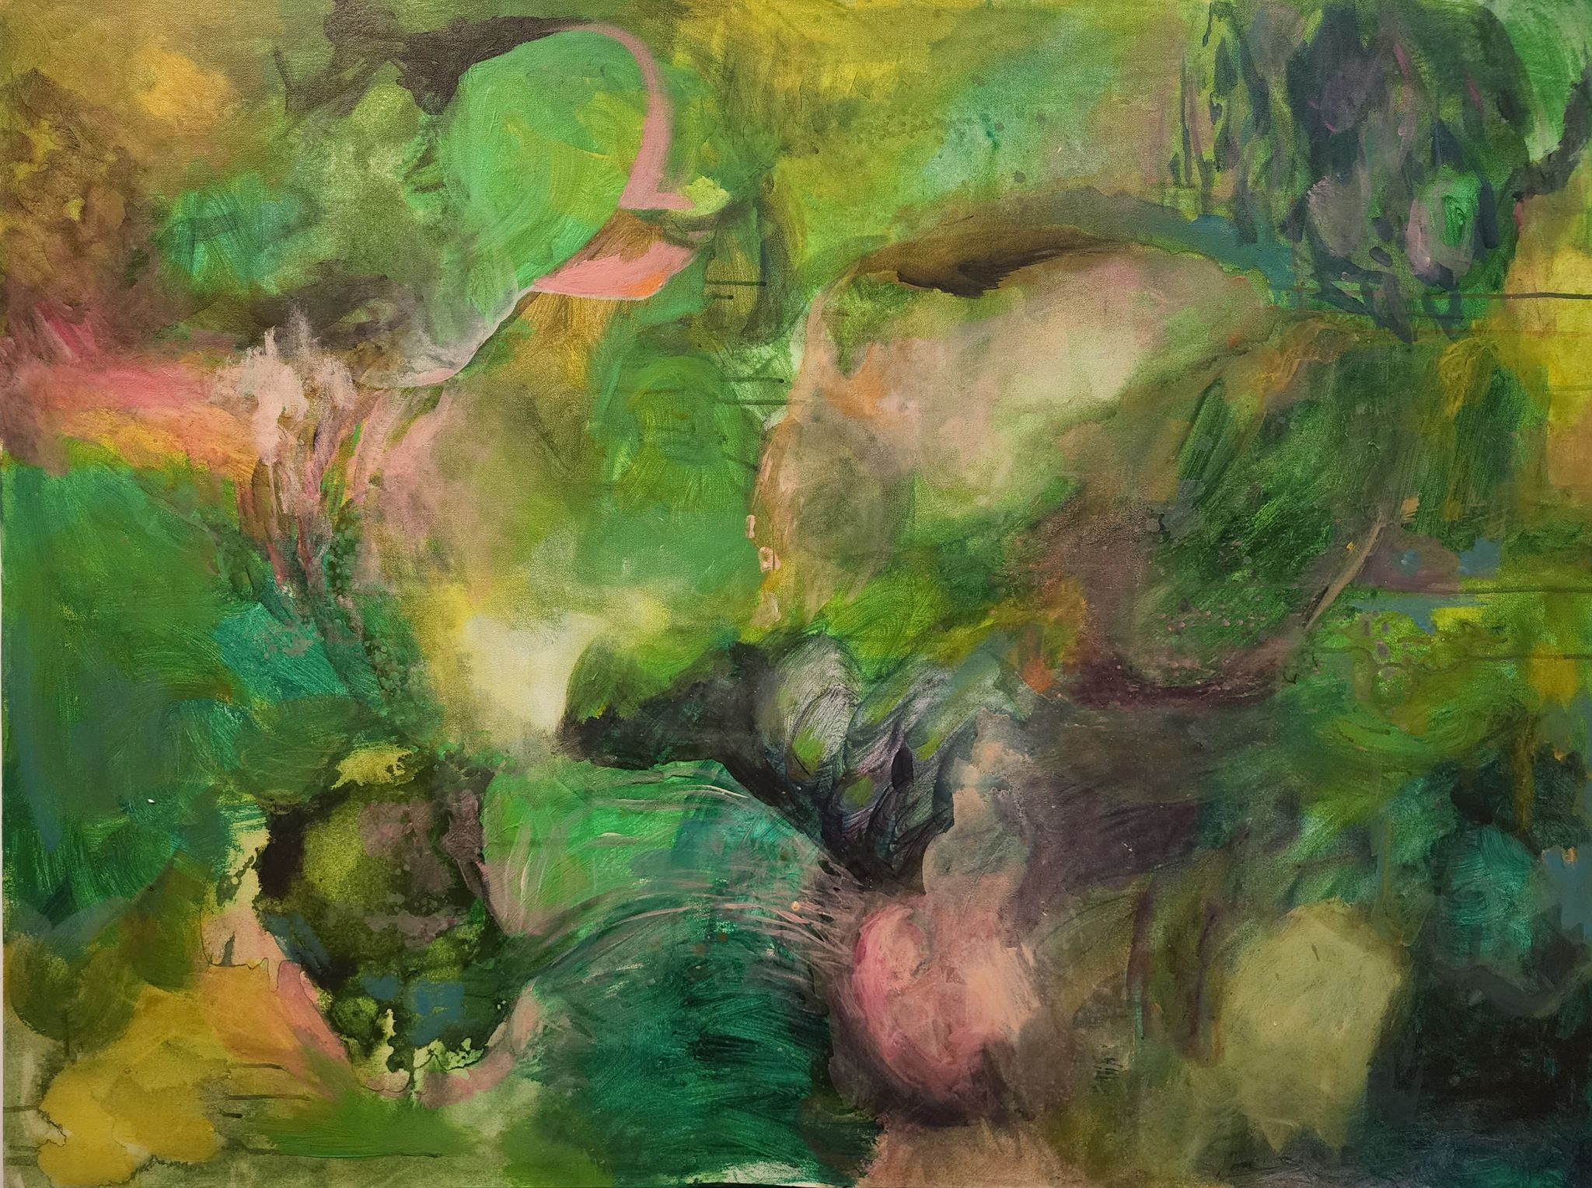
9
2.5ftx4ft
Acrylic on Canvas
2022
Price: Rs. 145,000

Slide 11
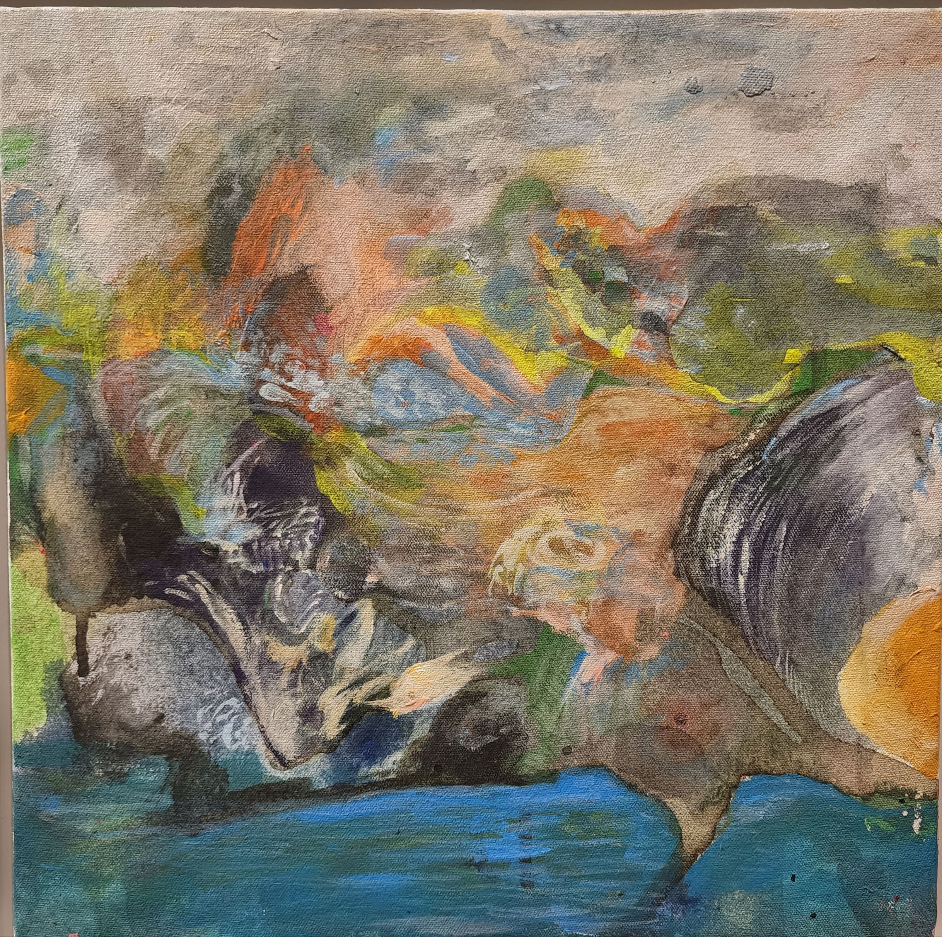
10
1ftx1ft
Acrylic on Canvas
2022
Price: Rs. 65,000

Slide 12
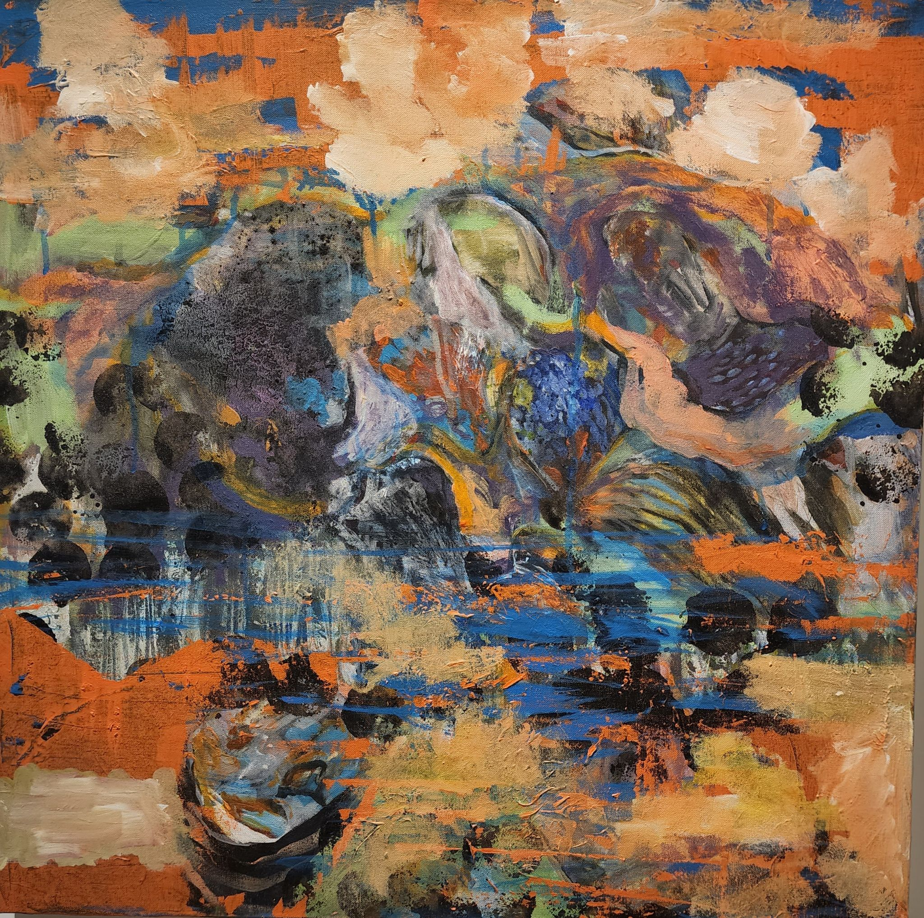
11
2ftx2ft
Acrylic on Canvas
2021
Price: Rs. 95,000

Slide 13
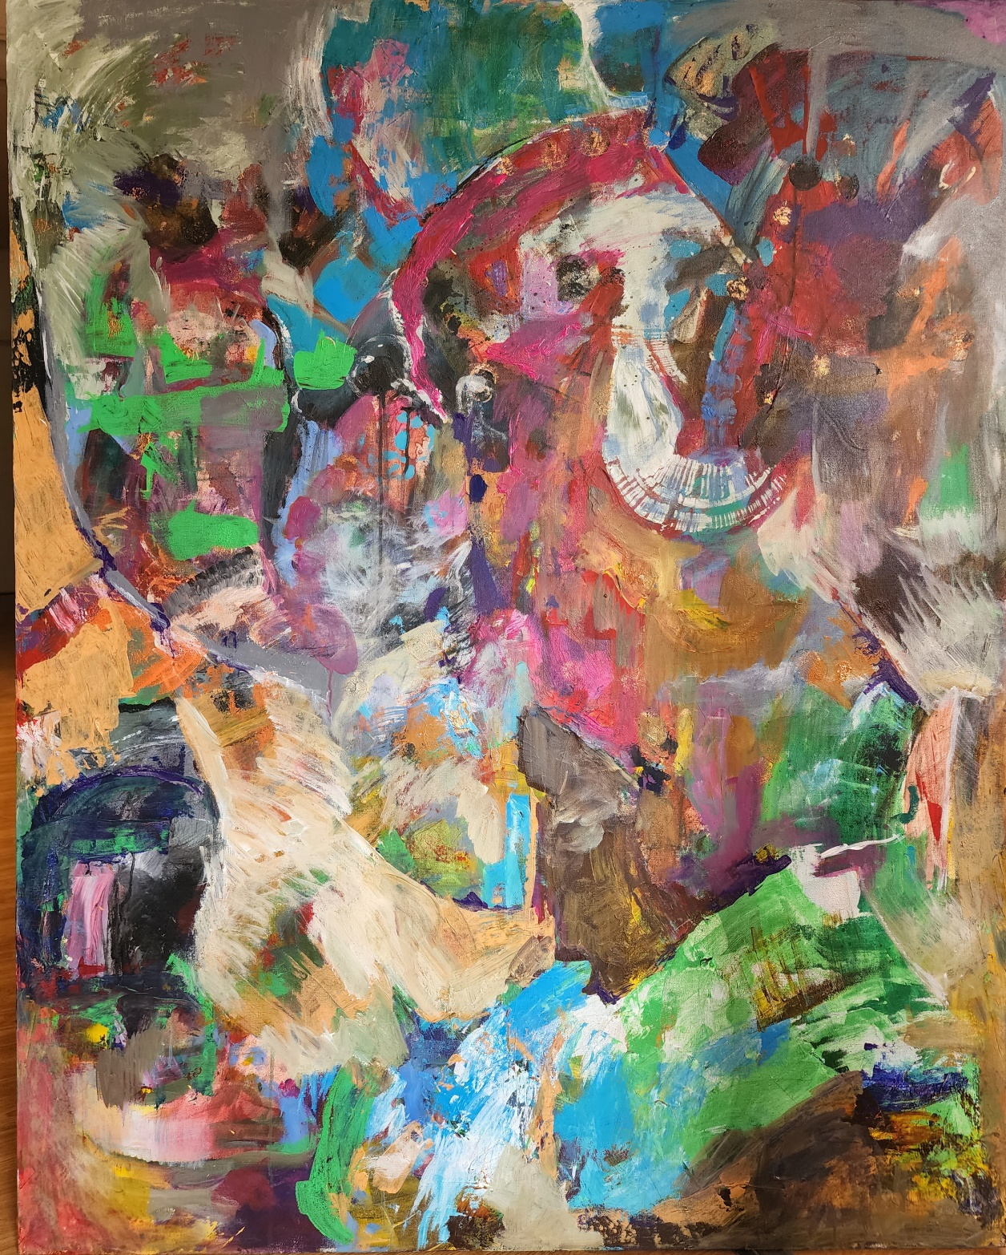
12
5ftx4ft
Acrylic on Canvas
2022
Price: Rs. 185,000

Slide 14
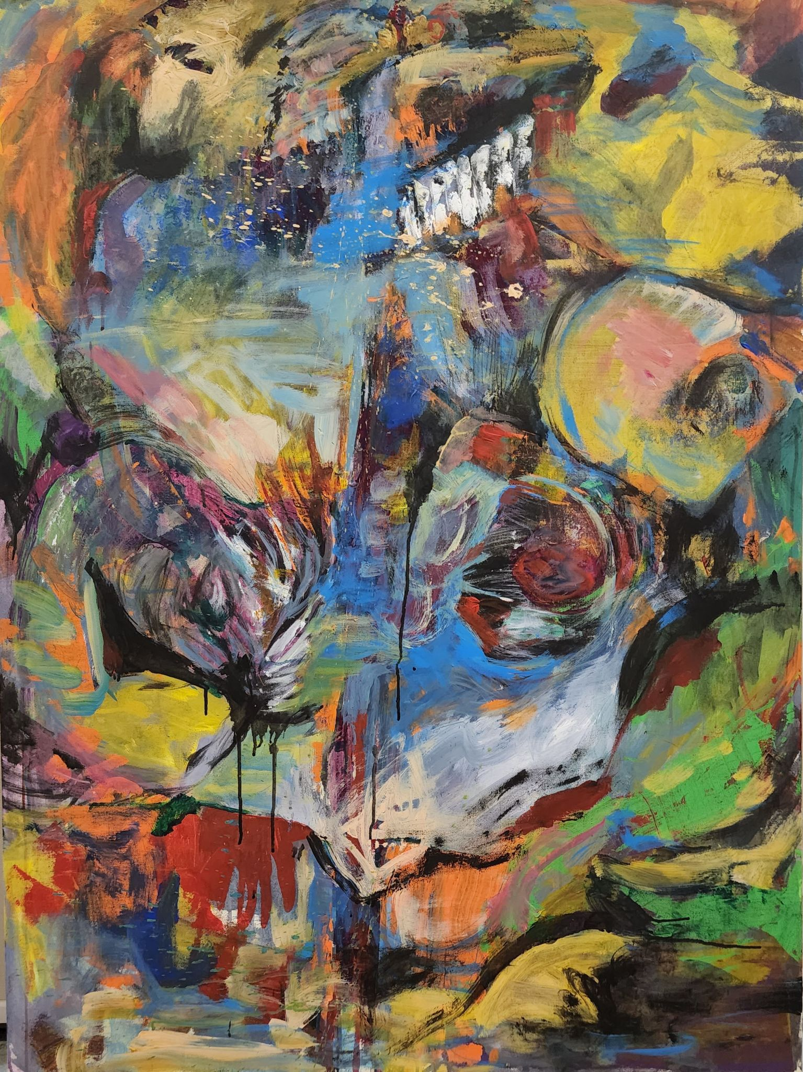
13
4ftx3ft
Acrylic on Canvas
2022
Price: Rs. 145,000

Slide 15
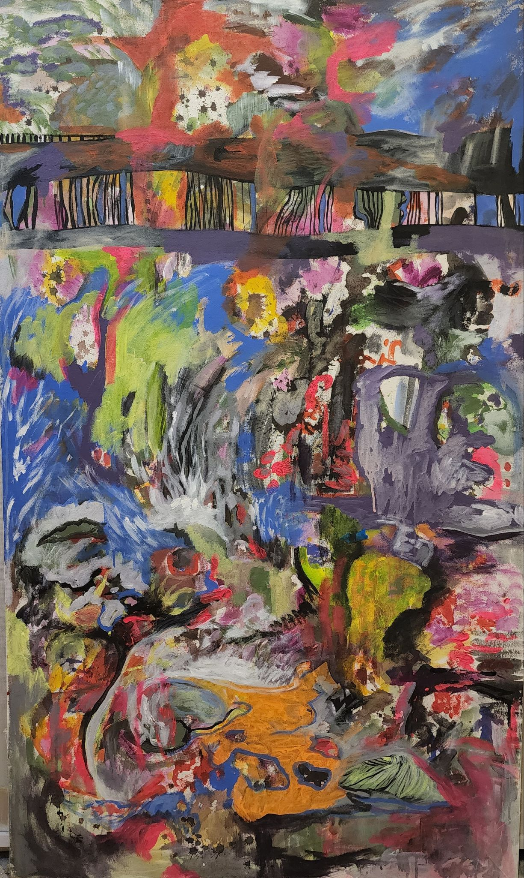
14
5ftx3ft
Acrylic on Canvas
2022
Price: Rs 175,000

Slide 16
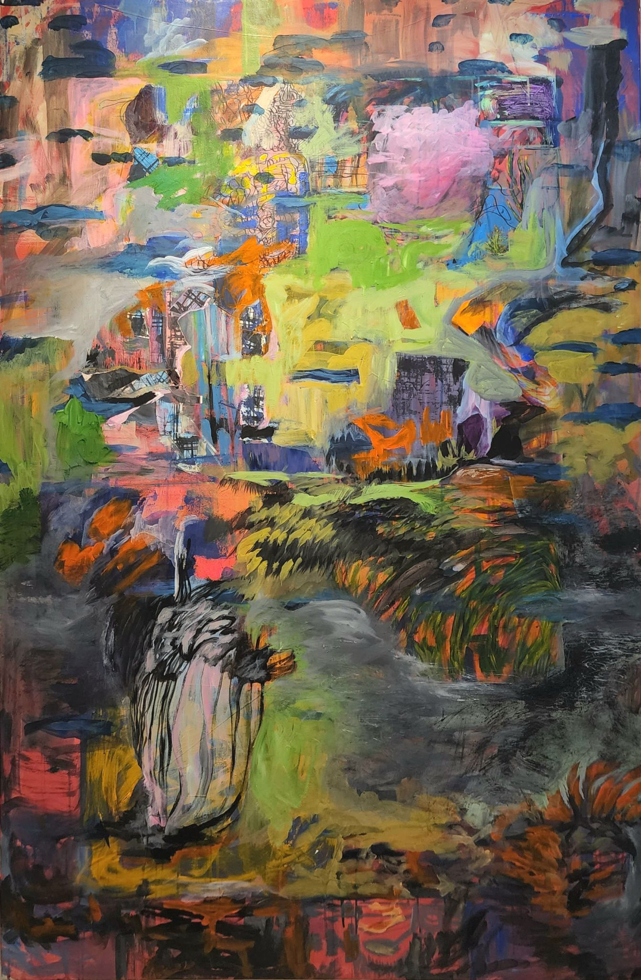
15
6ftx4ft
Acrylic on Canvas
2022
Price: Rs. 220,000

Slide 17
Artist Biography:
Nashmia Haroon is a multi disciplinary visual artist, also the founder and creative head of Tagh'eer Lahore Creative Space since 2020. With degrees in Fine Art lPainting) (2004) and M.A honors in Visual Art (2012) from the National College of Arts, Lahore, Pakistan, her practice revolves around mainly in painting and photography. Since the past few years, she has concentrated on exploring abstraction through painting, and the influence of music on it. Her interest of work previously based more on the changing urban landscape of major cities, presenting images made through photography and alternative printmaking -moving more into abstraction in the language of the visual.These works are architectonic in nature when produced in sculpture, drawing and video or photo montage. Other projects of Haroon are about making fictional collaborative works with other artists of Pakistan by taking their photographs in a pre-conceived environment that is reflective of their own practice. In others,she through fine art photography she looks at family structures and their social surroundings. Haroon has shown works in Pakistan widely, and in India, Cambodia, UK, USA, and has regularly published works in local magazines like ArtNow Pakistan, Herald, and internationally published with Reuters, The Boston Globe etc. Nashmia Haroon has taught at the Beaconhouse National University and the National college of Arts Lahore Tagheerlahorecs@gmail.com 03324602986 289 A Upper Mall, Lahore, Pakistan

