Slide 1
Part and Parcel
Artist statement #jenshireenmailart
In the experimental artistic simmer of the late 1950s, the everyday creativity of letter-writing gave rise to a veritable movement: that of “mail art,” an antiestablishment, anything-goes mode of serial imaginative expression whose inclusive nature has kept it alive even into the Digital Age. During early 2020 two artists met virtually and decided to create a body of work together using the mail and social media as their connection. They were unaware that is project would be shaped by a worldwide pandemic. This blend of creative and intellectual exchange became a part and parcel of their mail art experience. Both. Jennifer Rae Forsyth and Shireen Ikramullah Khan began a series of postcard sized pieces respectively starting from the first day of spring during the year 2020. Having never met in person, they embarked on a project during the omnipresent pandemic. They left enough mental and physical space for each other to contribute to each other’s pieces. Jennifer in Edmonton, Canada and Shireen in Amsterdam, The Netherlands and later Berlin, Germany. It was like a story where one artist would begin with an image, and the other artist would begin to add her own story, apropos of continuing the story and her own imagination. Both Jennifer and Shireen felt connected to a wider movement that in fact reached out to people who were isolated by posting their pieces on social media once a week. On the following Thursday each week of the year that followed the postcards were posted on social media and compiled to be mailed so they could be worked into.

Slide 2
One year later the two artists have created 104 posts, or 52 artworks, one for each week, some presented as diptychs. The artworks, created on watercolour postcards measuring 14.8cm x 10.5cm and 12.5 x 18cm respectively, are mixed media collage works with watercolour, acrylic gouache, and ink. Each work was mailed with correspondence on the reverse and returned, completed by the other with a corresponding letter. As 2020 unfolded and Jennifer and Shireen found themselves facing varied levels of lockdown. The works reflected this. The work incorporates maps and floorplans, airplane safety instructions, found images and text, drawing, painting, and handwriting. Over the year the images and marking evolved and changed.
Their everyday aesthetic experiences had a profound impact on their lives, their corresponding identity and view of the world. The imagery by each respective artist came to influence each other. The underset layers of colours, the aesthetically composed collage, linear qualities creating dimensions into other worlds are clearly recognizable. By introducing geometric, biomorphic forms and content in our work, the imagery tends to be emotionally along with being disquieting. In the end it widened the space in which they understood art could be made and pushed boundaries. In a manner of speaking, this contemporary practice spoke to the same ethos of mail art, being freely given and collaborative. Nothing beat the experience of sending and receiving classic, tangible mail art.
(Jennifer Rae Forsyth and Shireen Ikramullah Khan)

Slide 3
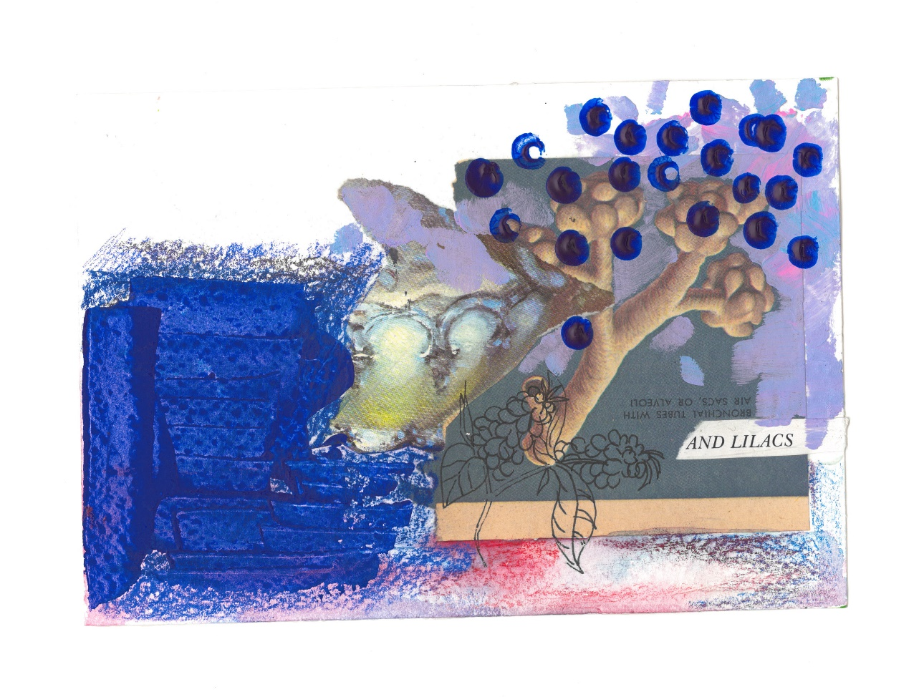
Jennifer Rae Forsyth and Shireen Ikramullah Khan
Mix media on watercolour paper
12.5 x 18cm
2020
Rs20,000

Slide 4
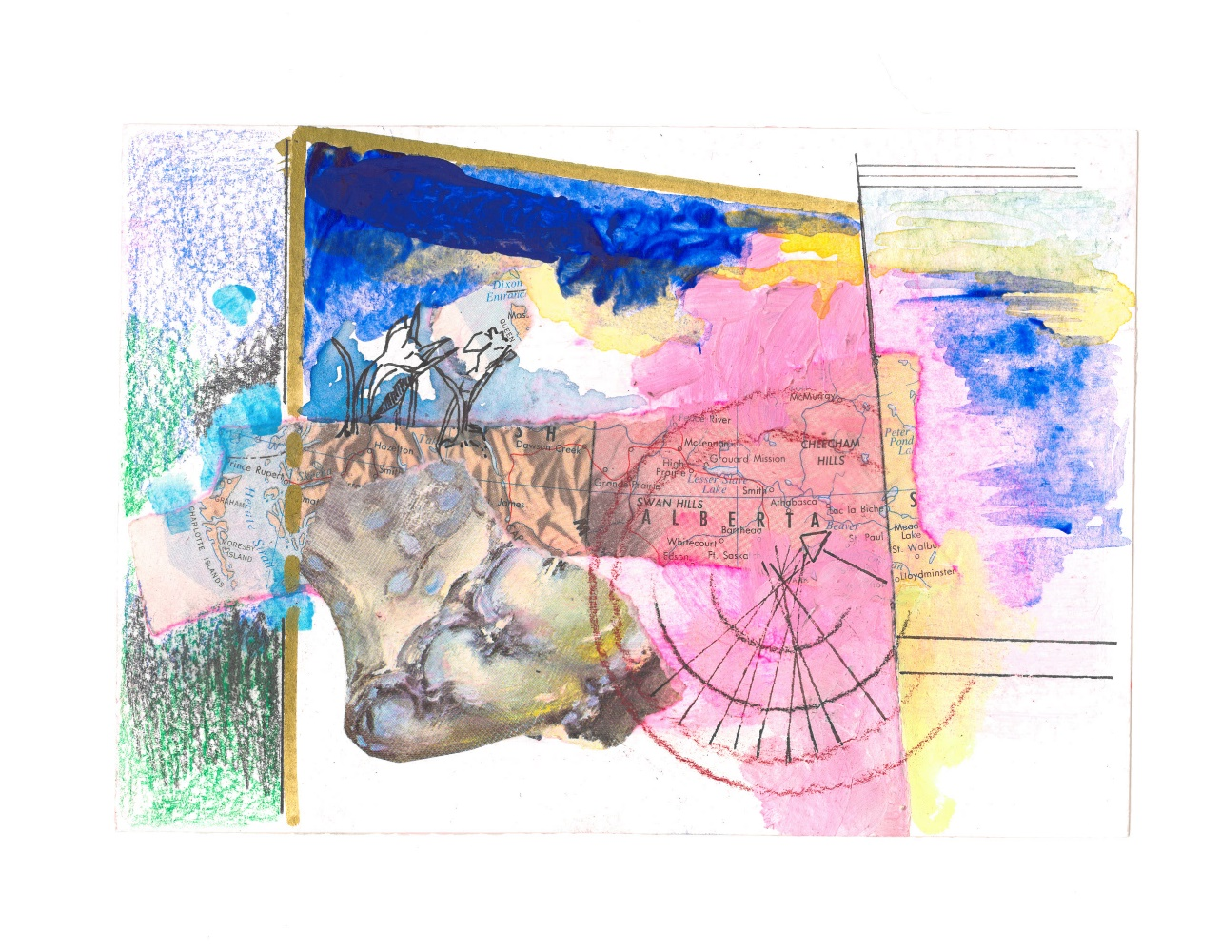
Jennifer Rae Forsyth and Shireen Ikramullah Khan
Mix media on watercolour paper
12.5 x 18cm
2020
Rs20,000

Slide 5
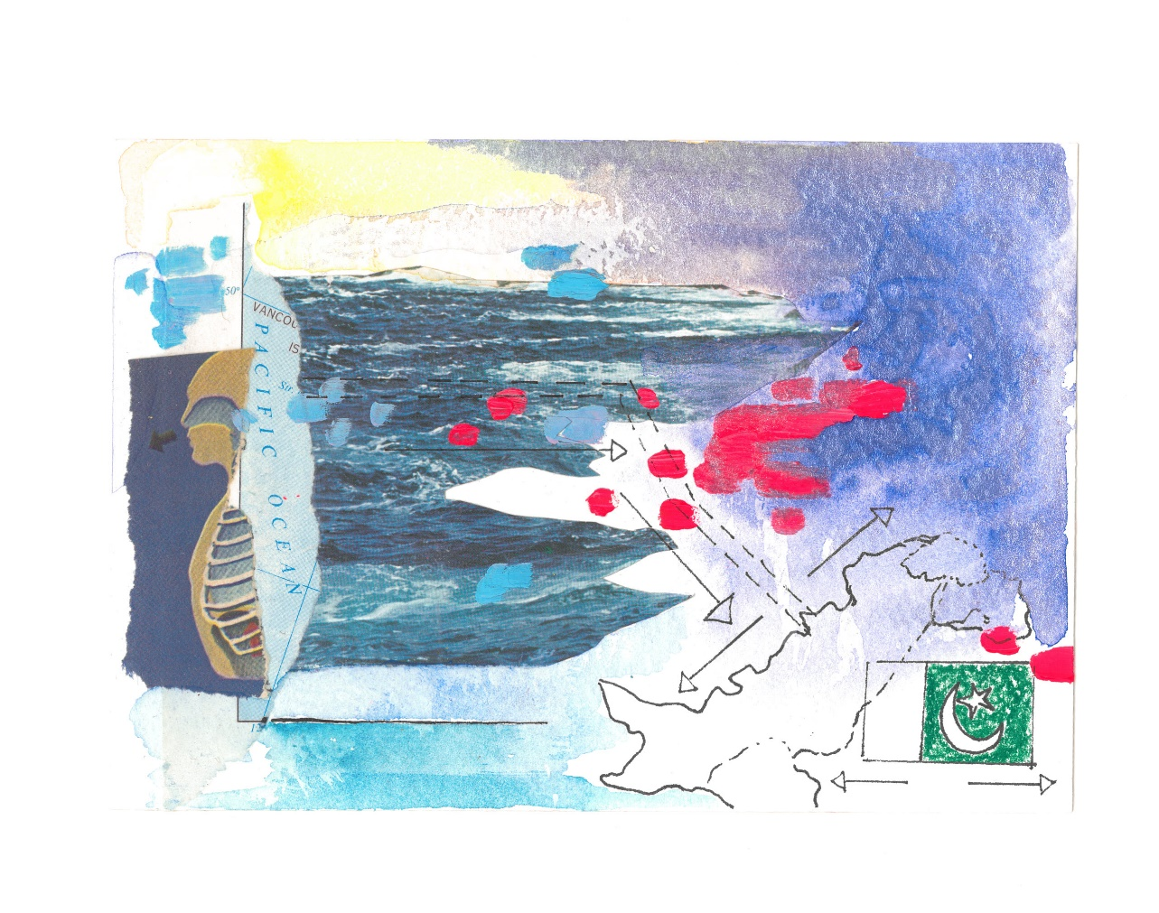
Jennifer Rae Forsyth and Shireen Ikramullah Khan
Mix media on watercolour paper
12.5 x 18cm
2020
Rs20,000

Slide 6
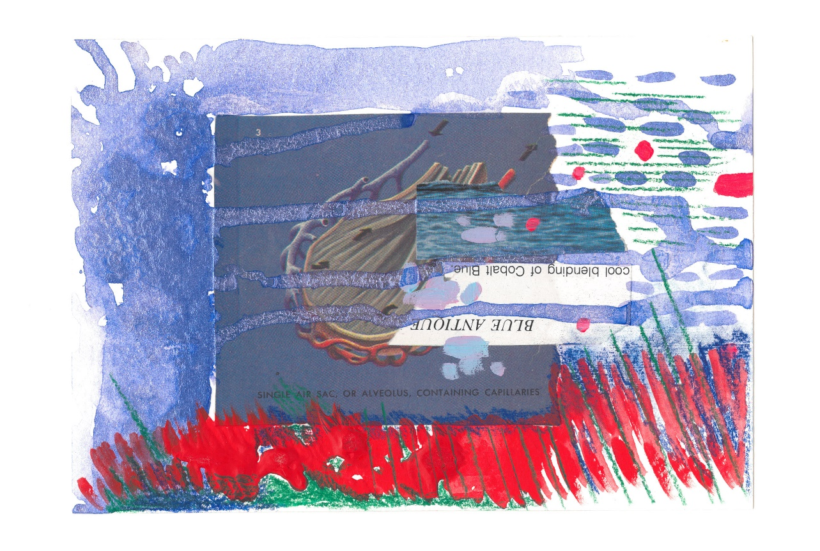
Jennifer Rae Forsyth and Shireen Ikramullah Khan
Mix media on watercolour paper
12.5 x 18cm
2020
Rs20,000

Slide 7
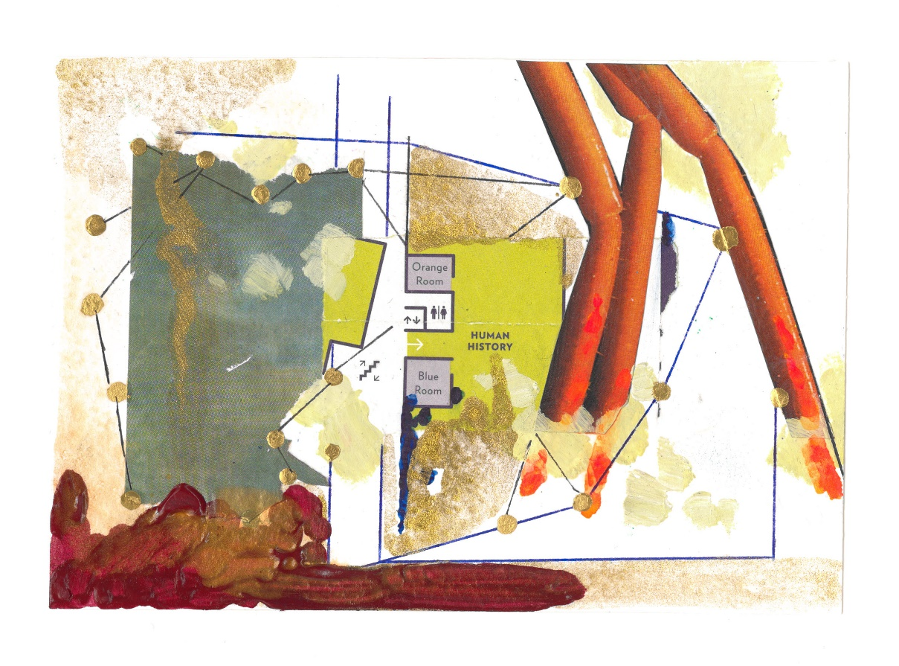
Jennifer Rae Forsyth and Shireen Ikramullah Khan
Mix media on watercolour paper
12.5 x 18cm
2020
Rs20,000

Slide 8
Jennifer Rae Forsyth and Shireen Ikramullah Khan
Mix media on watercolour paper
12.5 x 18cm
2020
Rs20,000

Slide 9
Jennifer Rae Forsyth and Shireen Ikramullah Khan
Mix media on watercolour paper
12.5 x 18cm
2020
Rs20,000

Slide 10
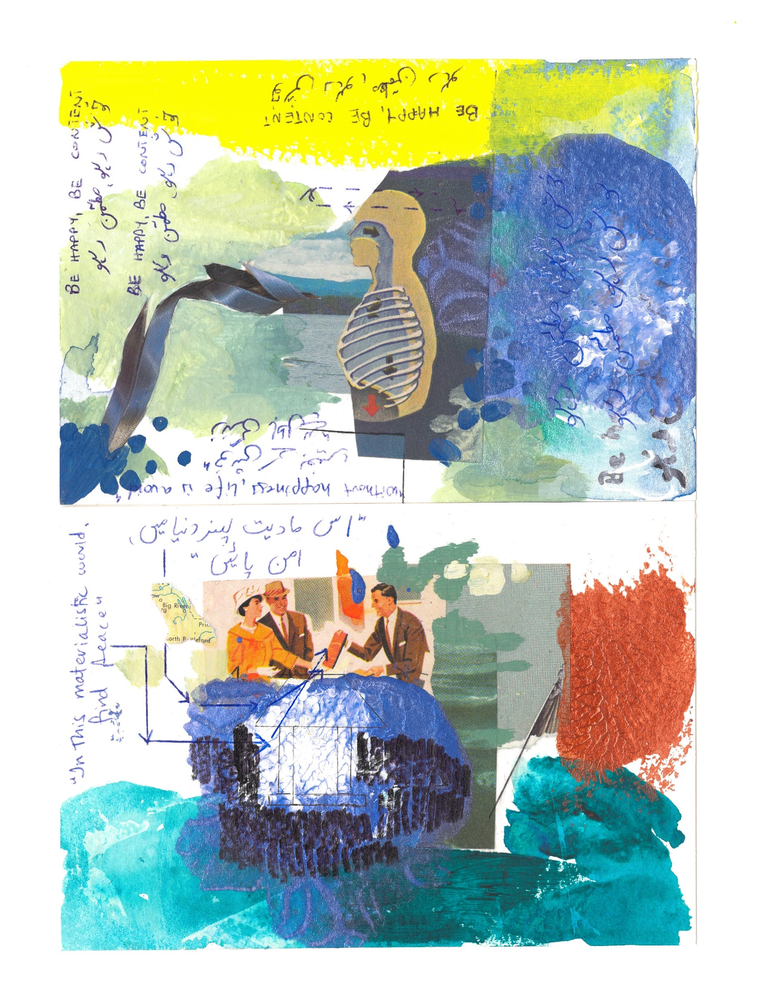
Jennifer Rae Forsyth and Shireen Ikramullah Khan
(diptych)
Mix media on watercolour paper
12.5 x 18cm each
2020
Rs35,000

Slide 11
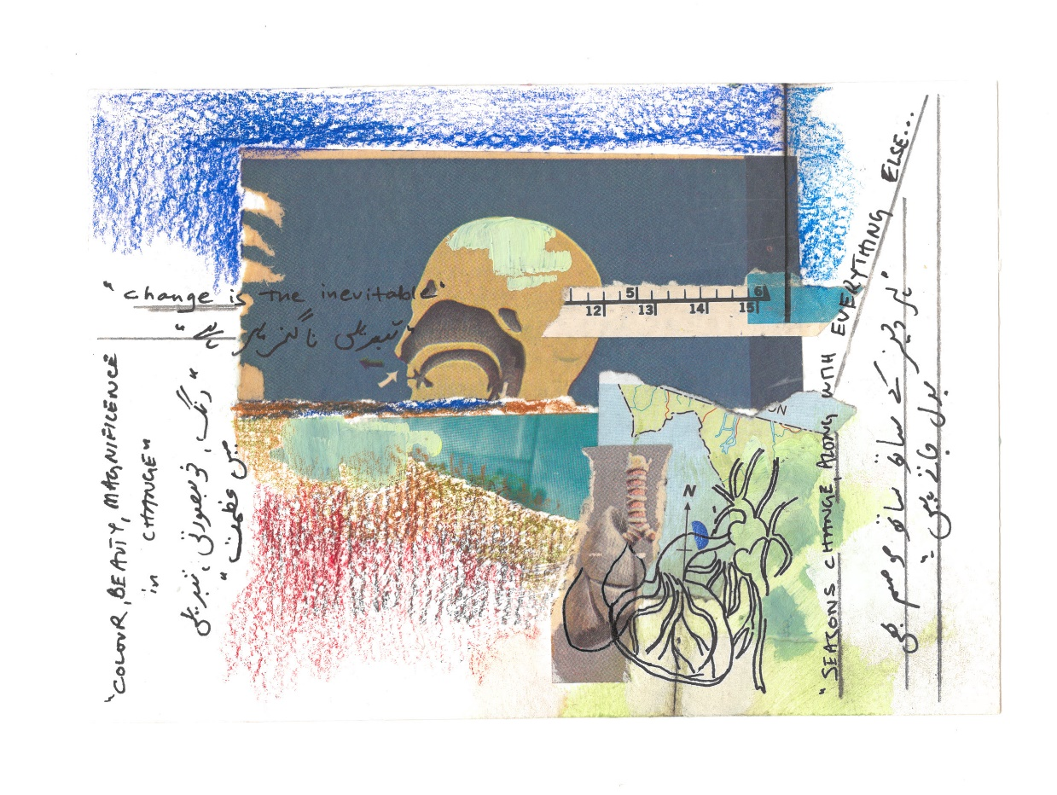
Jennifer Rae Forsyth and Shireen Ikramullah Khan
Mix media on watercolour paper
12.5 x 18cm
2020
Rs20,000

Slide 12
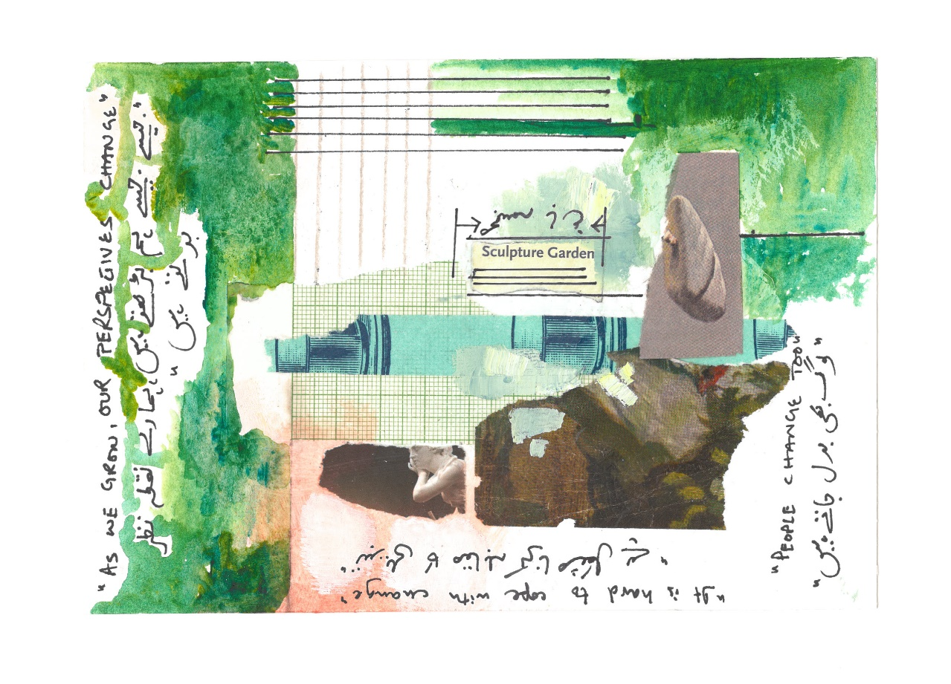
Jennifer Rae Forsyth and Shireen Ikramullah Khan
Mix media on watercolour paper
12.5 x 18cm
2020
Rs20,000

Slide 13
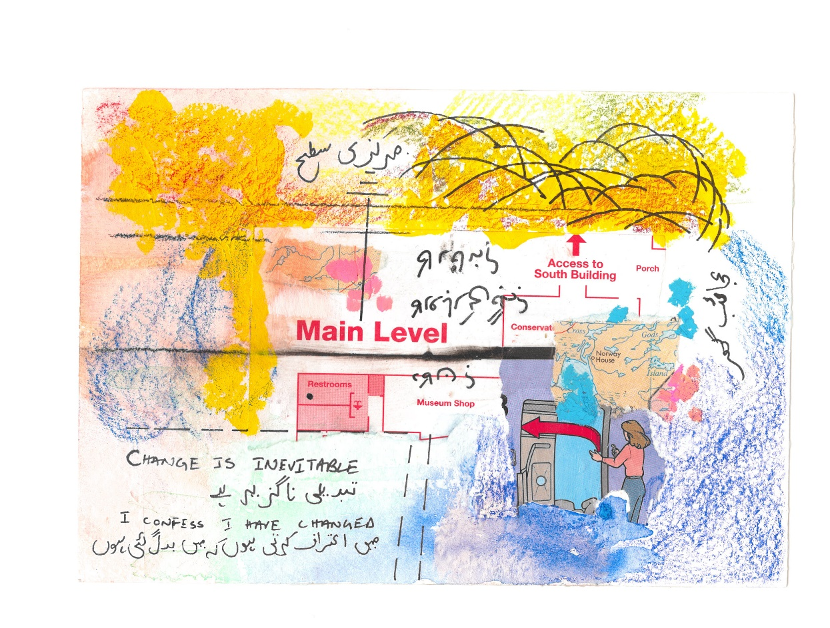
Jennifer Rae Forsyth and Shireen Ikramullah Khan
Mix media on watercolour paper
12.5 x 18cm
2020
Rs20,000

Slide 14
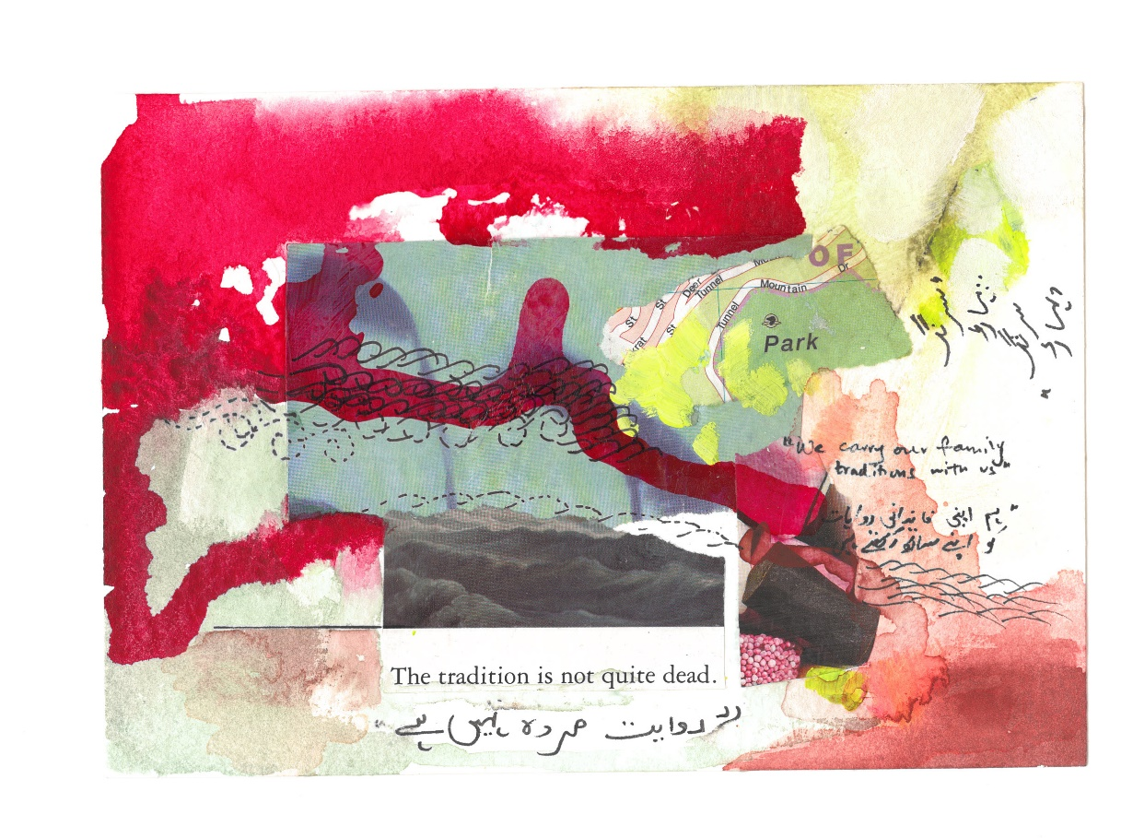
Jennifer Rae Forsyth and Shireen Ikramullah Khan
Mix media on watercolour paper
12.5 x 18cm
2020
Rs20,000

Slide 15
Jennifer Rae Forsyth and Shireen Ikramullah Khan
Mix media on watercolour paper
12.5 x 18cm
2020
Rs20,000

Slide 16
Jennifer Rae Forsyth and Shireen Ikramullah Khan
Mix media on watercolour paper
12.5 x 18cm
2020
Rs20,000

Slide 17
Jennifer Rae Forsyth and Shireen Ikramullah Khan
Mix media on watercolour paper
12.5 x 18cm
2020
Rs20,000

Slide 18
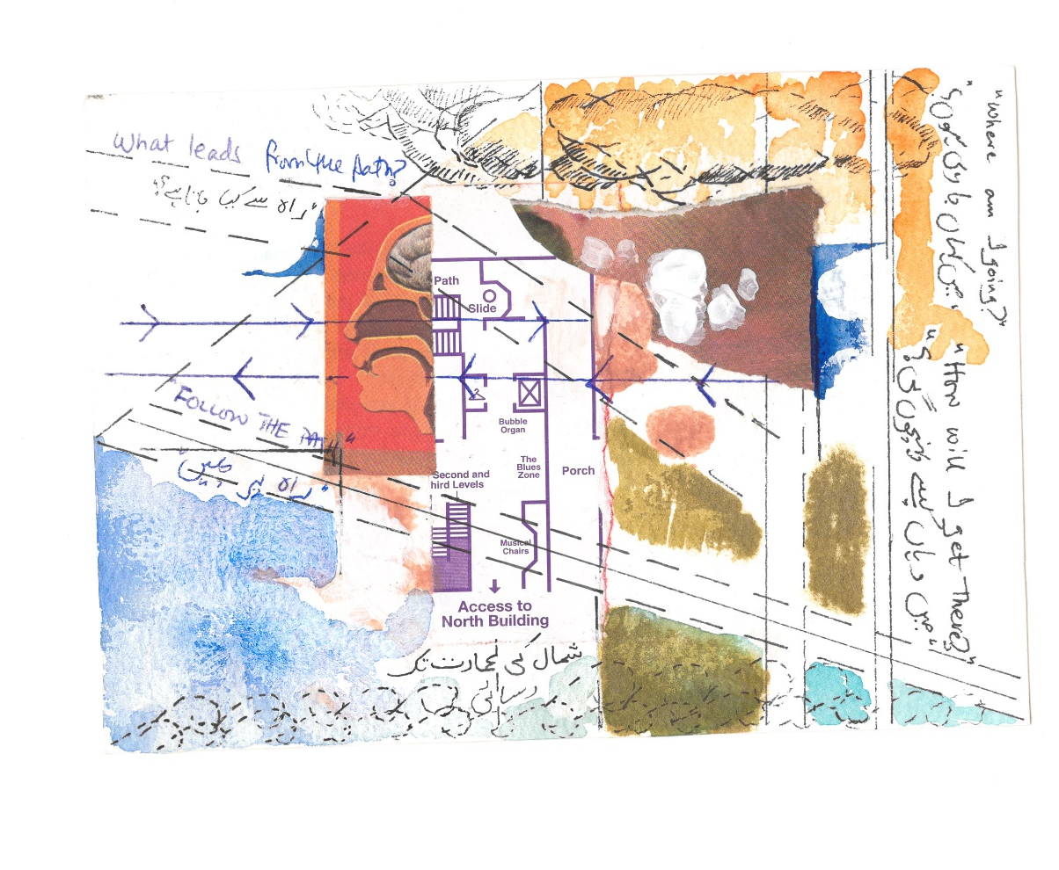
Jennifer Rae Forsyth and Shireen Ikramullah Khan
Mix media on watercolour paper
12.5 x 18cm
2020
Rs20,000

Slide 19
Jennifer Rae Forsyth and Shireen Ikramullah khan
Mix media on watercolour paper
12.5 x 18cm
2020
Rs20,000

Slide 20
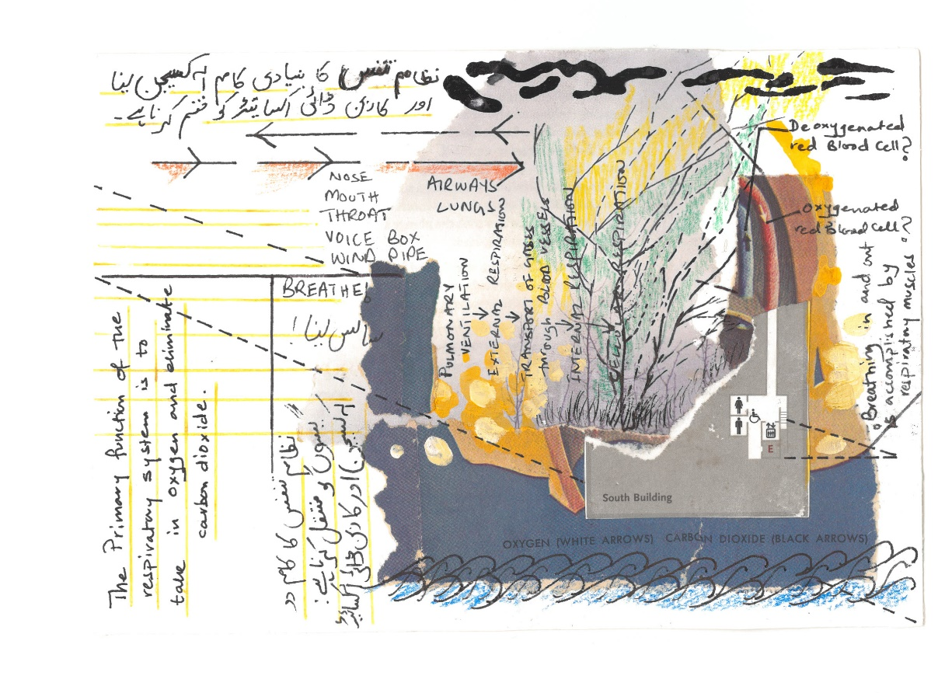
Jennifer Rae Forsyth and Shireen Ikramullah Khan
Mix media on watercolour paper
12.5 x 18cm
2020
Rs20,000

Slide 21
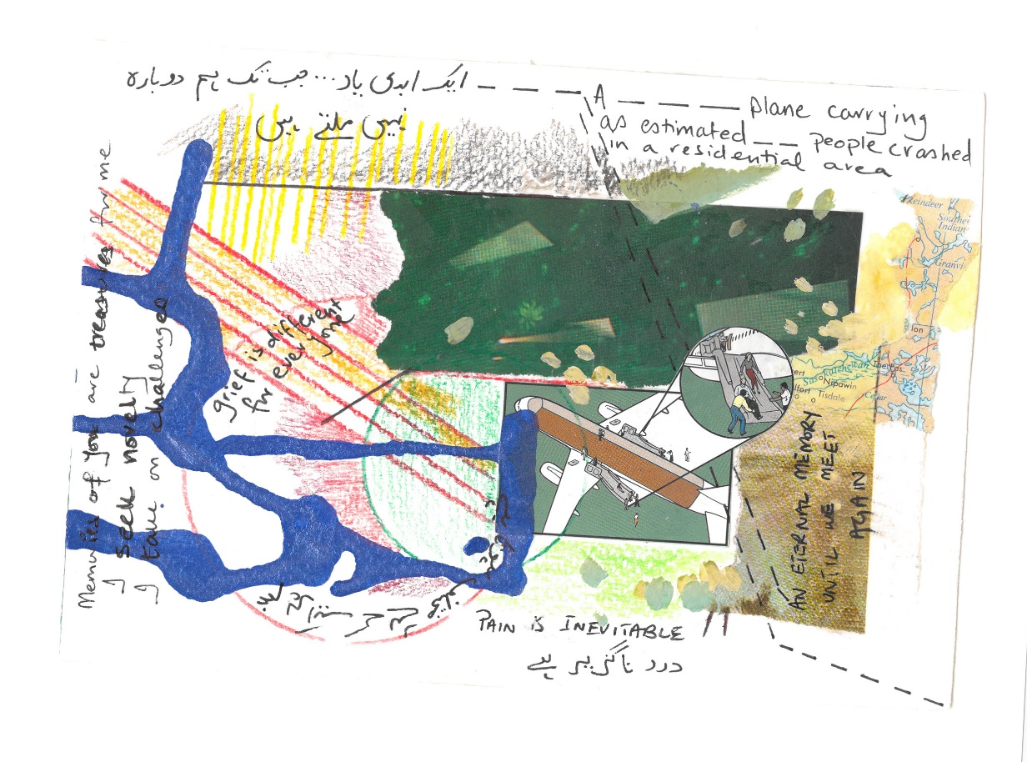
Jennifer Rae Forsyth and Shireen Ikramullah Khan
Mix media on watercolour paper
12.5 x 18cm
2020
Rs20,000

Slide 22
Jennifer Rae Forsyth and Shireen Ikramullah Khan
Mix media on watercolour paper
12.5 x 18cm
2020
Rs20,000

Slide 23
Jennifer Rae Forsyth and Shireen Ikramullah Khan
Mix media on watercolour paper
12.5 x 18cm
2020
Rs20,000

Slide 24
Jennifer Rae Forsyth and Shireen Ikramullah Khan
Mix media on watercolour paper
12.5 x 18cm
2020
Rs20,000

Slide 25
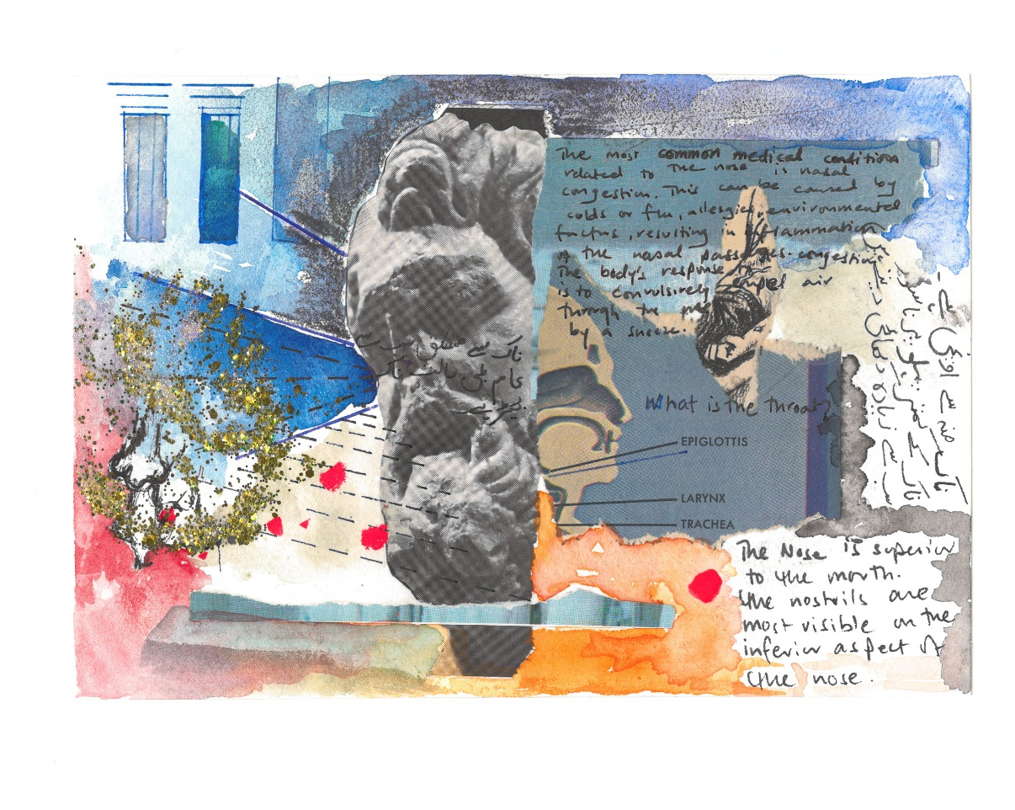
Jennifer Rae Forsyth and Shireen Ikramullah Khan
Mix media on watercolour paper
12.5 x 18cm
2020
Rs20,000

Slide 26
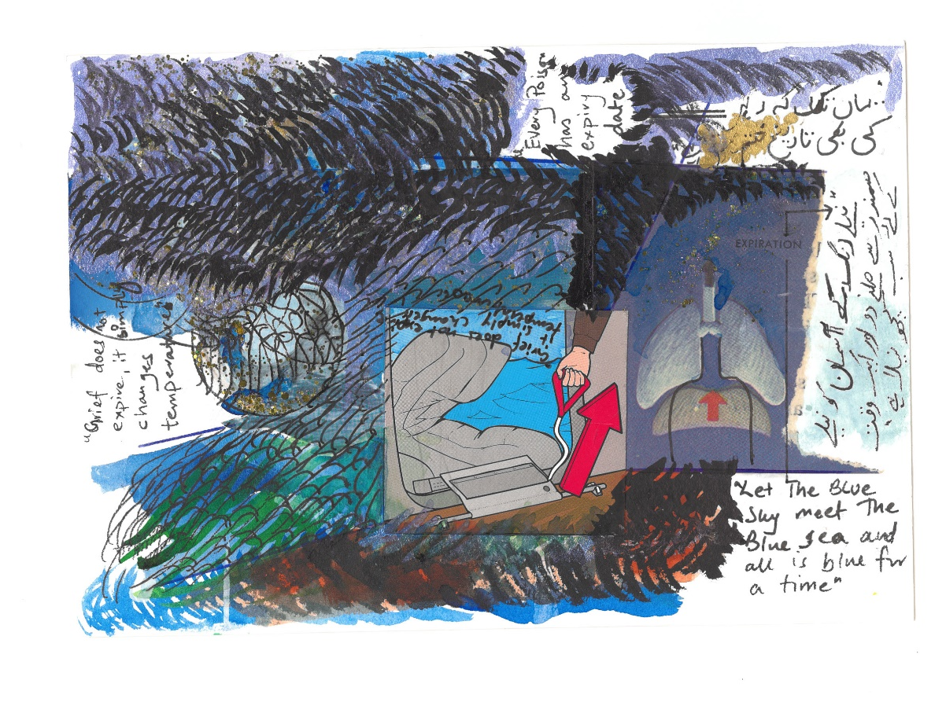
Jennifer Rae Forsyth and Shireen Ikramullah Khan
Mix media on watercolour paper
12.5 x 18cm
2020
Rs20,000

Slide 27
Jennifer Rae Forsyth and Shireen Ikramullah Khan
Mix media on watercolour paper
12.5 x 18cm
2020
Rs20,000

Slide 28
Jennifer Rae Forsyth and Shireen Ikramullah Khan
Mix media on watercolour paper
12.5 x 18cm
2020
Rs20,000

Slide 29
Jennifer Rae Forsyth and Shireen Ikramullah Khan
14.8cm x 10.5cm
Mix media on watercolour paper
2020
Rs20,000

Slide 30
Jennifer Rae Forsyth and Shireen Ikramullah Khan
Mix media on watercolour paper
14.8cm x 10.5cm
2020
Rs20,000

Slide 31
Jennifer Rae Forsyth and Shireen Ikramullah Khan
Mix media on watercolour paper
14.8cm x 10.5cm
2020
Rs20,000

Slide 32
Jennifer Rae Forsyth and Shireen Ikramullah Khan
Mix media on watercolour paper
14.8cm x 10.5cm
2020
Rs20,000

Slide 33
Jennifer Rae Forsyth and Shireen Ikramullah Khan
Mix media on watercolour paper
14.8cm x 10.5cm
2020
Rs20,000

Slide 34
Jennifer Rae Forsyth and Shireen Ikramullah Khan
Mix media on watercolour paper
14.8cm x 10.5cm
2020
Rs20,000

Slide 35
Jennifer Rae Forsyth and Shireen Ikramullah Khan
Mix media on watercolour paper
14.8cm x 10.5cm
2020
Rs20,000

Slide 36
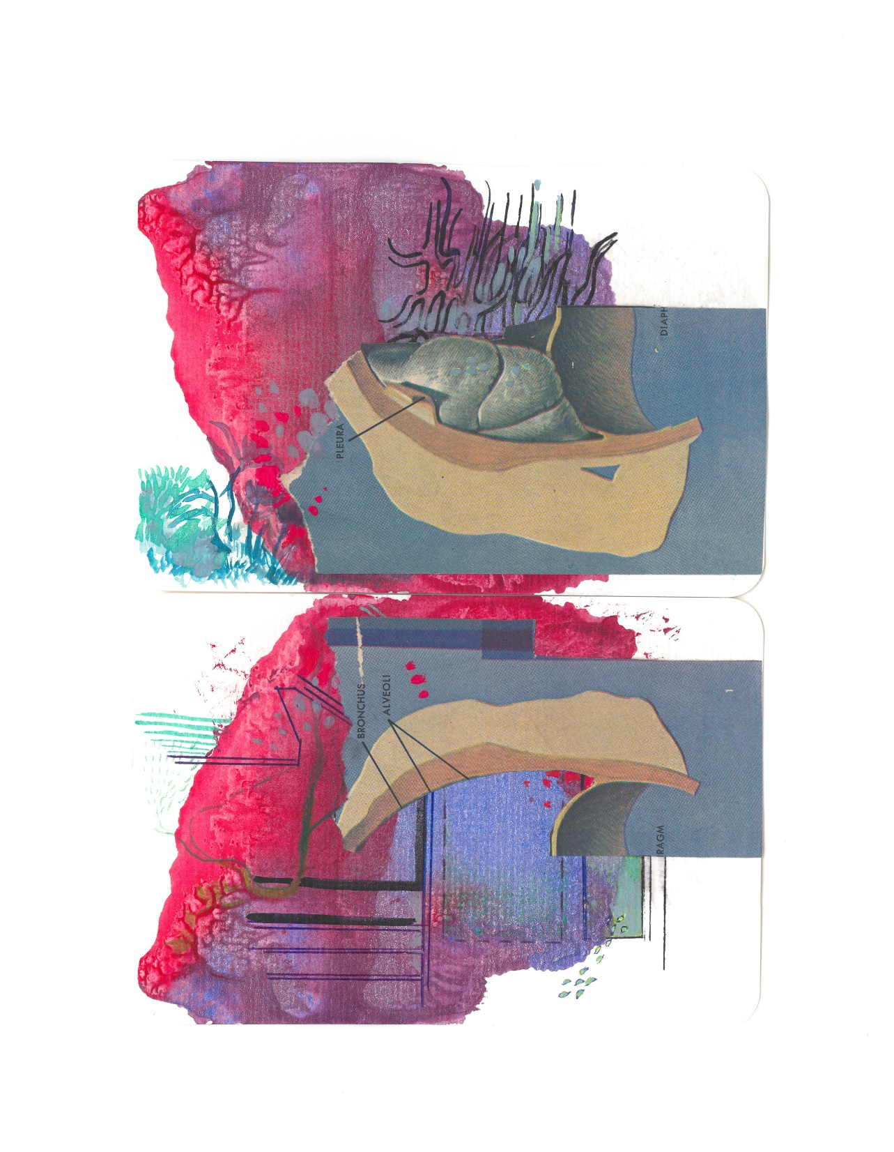
Jennifer Rae Forsyth and Shireen Ikramullah Khan
Mix media on watercolour paper
14.8cm x 10.5cm each
(Diptych)
2020
Rs35,000

Slide 37
Jennifer Rae Forsyth and Shireen Ikramullah Khan
Mix media on watercolour paper
14.8cm x 10.5cm
2020
Rs20,000

Slide 38
Jennifer Rae Forsyth and Shireen Ikramullah Khan
Mix media on watercolour paper
14.8cm x 10.5cm
2020
Rs20,000

Slide 39
Jennifer Rae Forsyth and Shireen Ikramullah Khan
Mix media on watercolour paper
14.8cm x 10.5cm
2020
Rs20,000

Slide 40
Jennifer Rae Forsyth and Shireen Ikramullah Khan
Mix media on watercolour paper
14.8cm x 10.5cm
2020
Rs20,000

Slide 41
Jennifer Rae Forsyth and Shireen Ikramullah Khan
Mix media on watercolour paper
14.8cm x 10.5cm
2020
Rs20,000

Slide 42
Jennifer Rae Forsyth and Shireen Ikramullah Khan
Mix media on watercolour paper
14.8cm x 10.5cm
2020
Rs20,000

Slide 43
Jennifer Rae Forsyth and Shireen Ikramullah Khan
Mix media on watercolour paper
14.8cm x 10.5cm
2020
Rs20,000

Slide 44
Jennifer Rae Forsyth and Shireen Ikramullah Khan
Mix media on watercolour paper
14.8cm x 10.5cm
2020
Rs20,000

Slide 45
Jennifer Rae Forsyth and Shireen Ikramullah Khan
Mix media on watercolour paper
14.8cm x 10.5cm
2020
Rs20,000

Slide 46
Jennifer Rae Forsyth and Shireen Ikramullah Khan
Mix media on watercolour paper
14.8cm x 10.5cm
2020
Rs20,000

Slide 47
Jennifer Rae Forsyth and Shireen Ikramullah Khan
Mix media on watercolour paper
14.8cm x 10.5cm
2020
Rs20,000

Slide 48
Jennifer Rae Forsyth and Shireen Ikramullah Khan
Mix media on watercolour paper
14.8cm x 10.5cm
2020
Rs20,000

Slide 49
Jennifer Rae Forsyth and Shireen Ikramullah Khan
Mix media on watercolour paper
14.8cm x 10.5cm
2020
Rs20,000

Slide 50
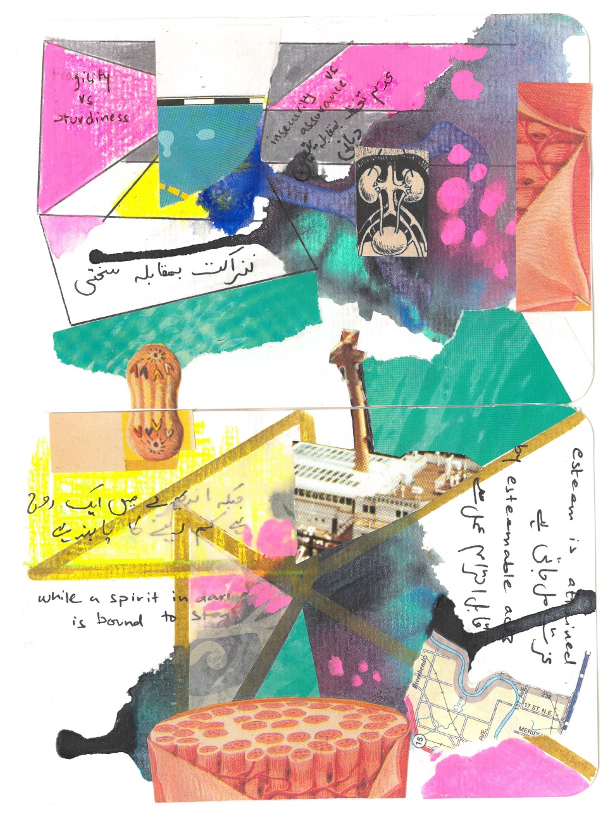
Jennifer Rae Forsyth and Shireen Ikramullah khan
Mix media on watercolour paper
(Diptych)
14.8cm x 10.5cm each
2020
Rs35,000

Slide 51
Jennifer Rae Forsyth and Shireen Ikramullah Khan
Mix media on watercolour paper
14.8cm x 10.5cm
2020
Rs20,000

Slide 52
Jennifer Rae Forsyth and Shireen Ikramullah Khan
Mix media on watercolour paper
14.8cm x 10.5cm
2020
Rs20,000

Slide 53
Jennifer Rae Forsyth and Shireen Ikramullah Khan
Mix media on watercolour paper
14.8cm x 10.5cm
2020
Rs20,000

Slide 54
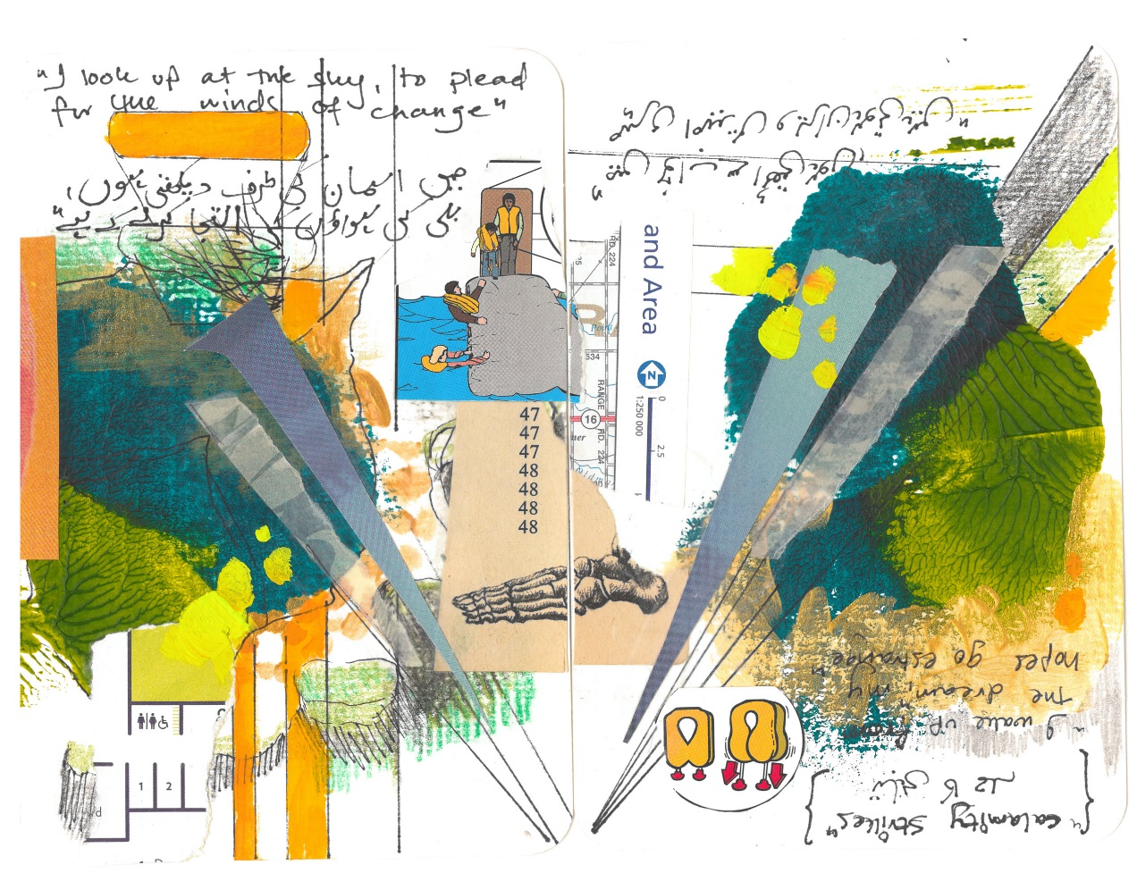
Jennifer Rae Forsyth and Shireen Ikramullah khan
Mix media on watercolour paper
(Diptych)
14.8cm x 10.5cm (each)
2020
Rs 35,000

