Slide 1
Retracing Spatial Memory
New works by Ayesha Naeem
Aymen Alam
Hafsa Nouman
Momina Javed
Nabeel Naveed

Slide 2
Ayesha feels she is unable to forget a home after the process of moving away from it. The remnant of their memory is left behind on her canvas. The study of architectural forms constructed with paper and the repetitive act of folding and unfolding which becomes synonymous to the packing and unpacking of a space. The artist is sensitive to the current situation of displacement in Pakistan due to one of the gravest natural disasters in the region.
The art practice of Aymen comprises of themes relating to nostalgia and surreal recollections of her childhood home. It deals particularly with the attachment and association of old spaces of her earlier years, derived from memorabilia of old reels and photographs.
Momina Javed uses the technique of miniature painting and manipulating the spaces depicted in her work considering them as a metaphor for human presence and evolution, regardless of the fact that there is figurative absence in the work. Her dream-like, fluid imagery is like a projection of warm sunlight on a flat surface, changing course slowly but surely on the surface of a wall.
Nabeel Naveed's aim is to map the execution and planning of urban fabric in restricted mobility and persistent encounter with elements of control. His exploration of found material i.e., locally sourced pamphlets, censored literature and recycled print media combines to map parallel(s) of dispossession through modes of commute, overdue supervision and abrupt obstruction.
Concerns of Hafsa's practice are the idea of exploring memory through an archaeological perspective-by treating the surface as an archaeological site, manifesting in her work and mind as a wall that allows the past, present and future to exist onto a single surface. This spatial reduction also allows her to explore transcendental qualities in her work. The building up of the many layers of paint and then excavating them, allowing chance to take precedence in developing the end visual.

Slide 3
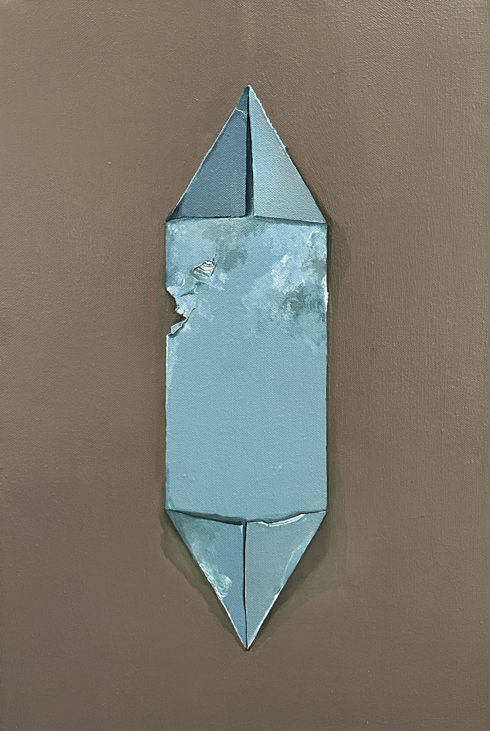
Ayesha Naeem
The three stages of memorizing a home: Step 1 oils and acrylics on canvas 18 x 12 inches Sold 2022

Slide 4
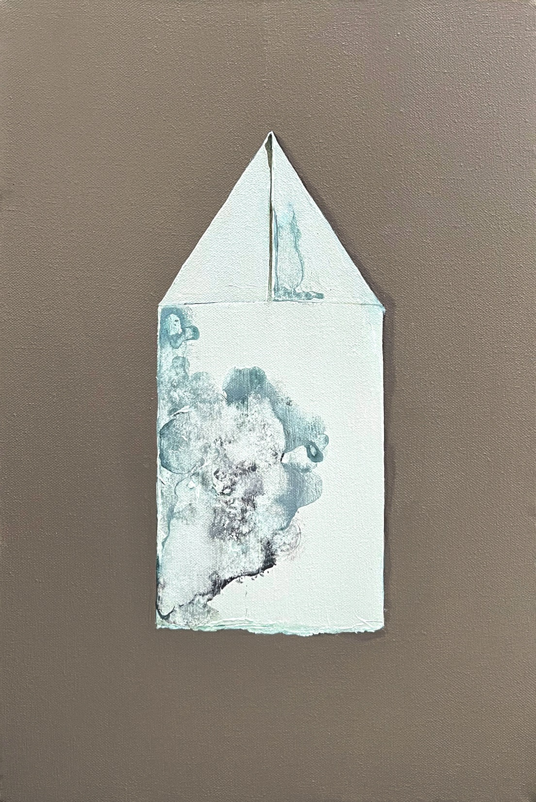
Ayesha Naeem
The three stages of memorizing a home: Step 2 Oils and Acrylics on canvas 18 x 12 inches Sold 2022

Slide 5
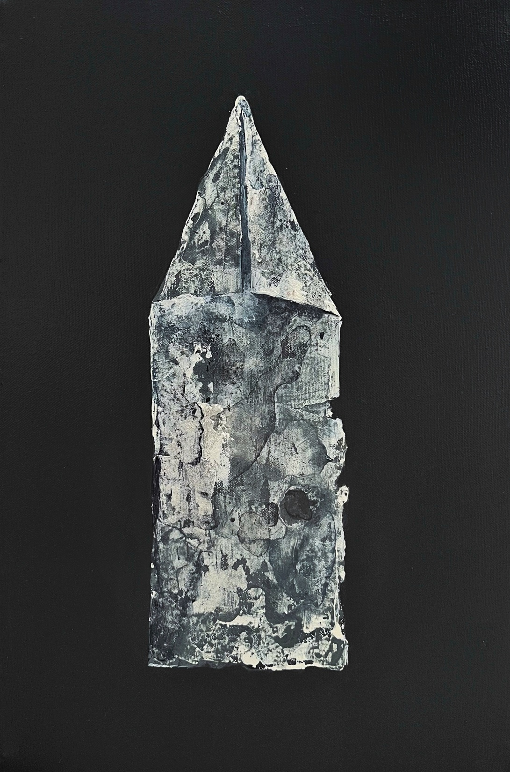
Ayesha Naeem
The three stages of memorizing a home: Step 3 Oils and acrylics on canvas 18 x 12 inches Sold 2022

Slide 6
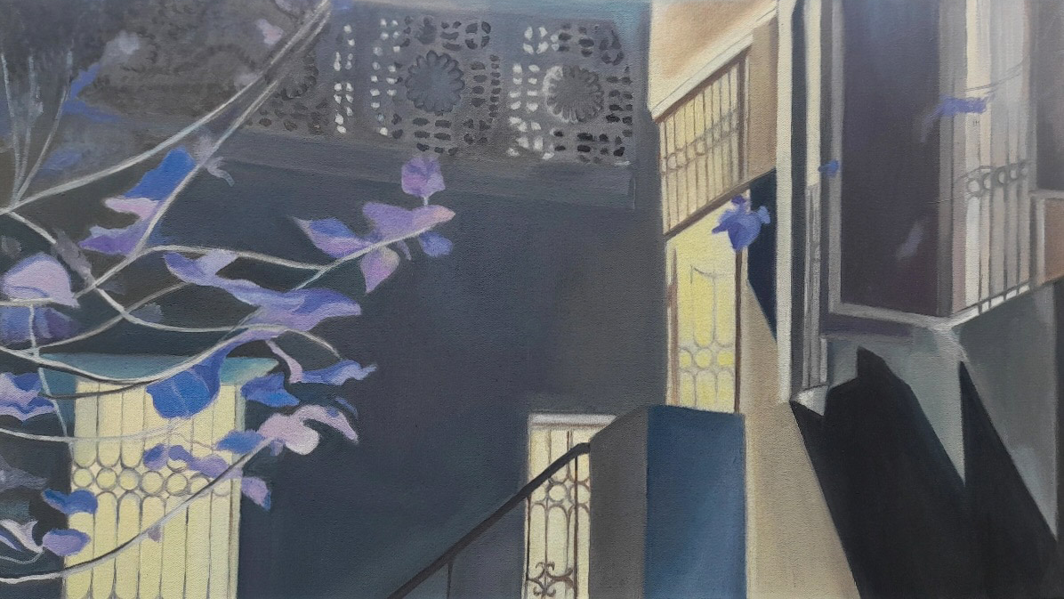
Aymen Alam
Through my eyes I
13.5×24 inches
Oil on canvas
PKR 35000

Slide 7
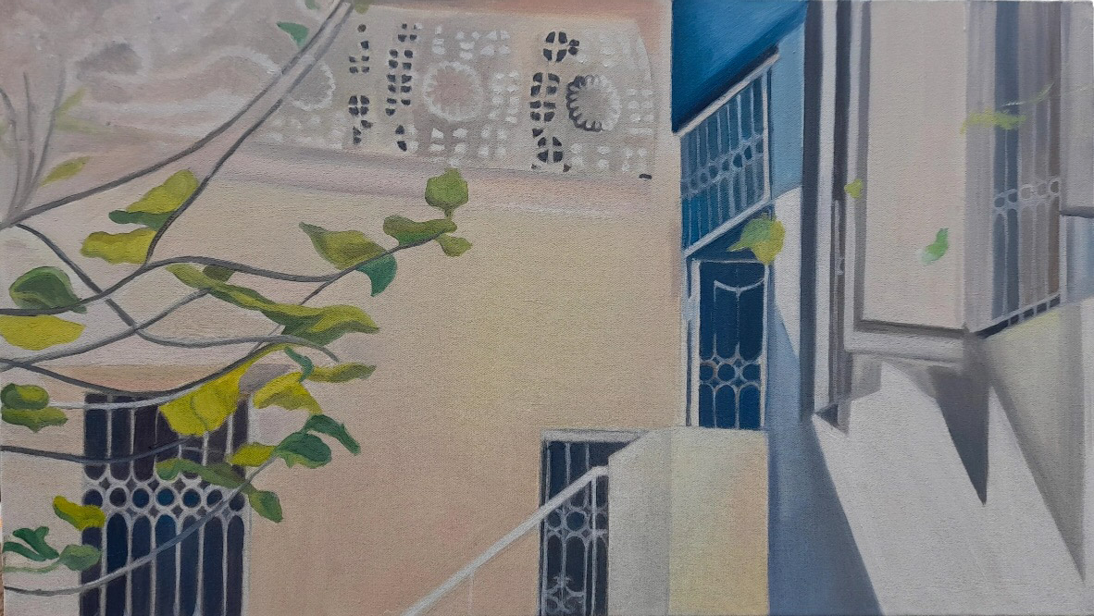
Aymen Alam
Through my eyes II
13.5×24 inches
Oil on canvas
PKR 35000

Slide 8
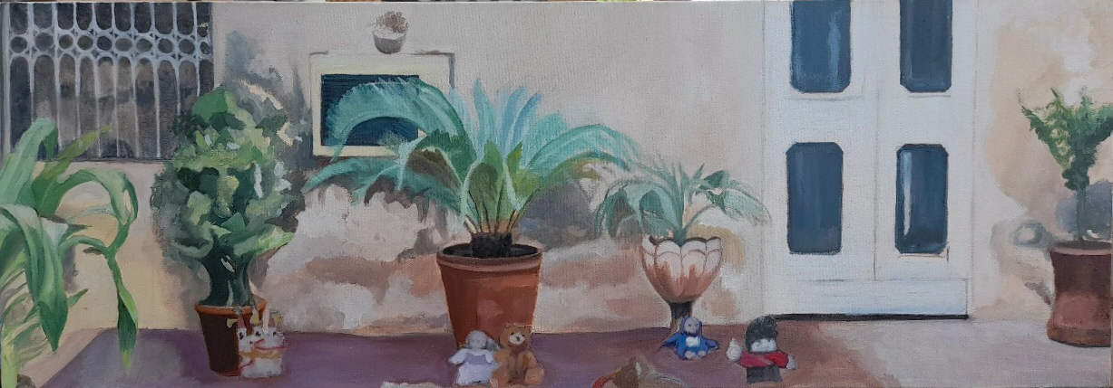
Aymen Alam
Little things
10.5×30 inches
Mixed media on canvas
PKR 35000

Slide 9
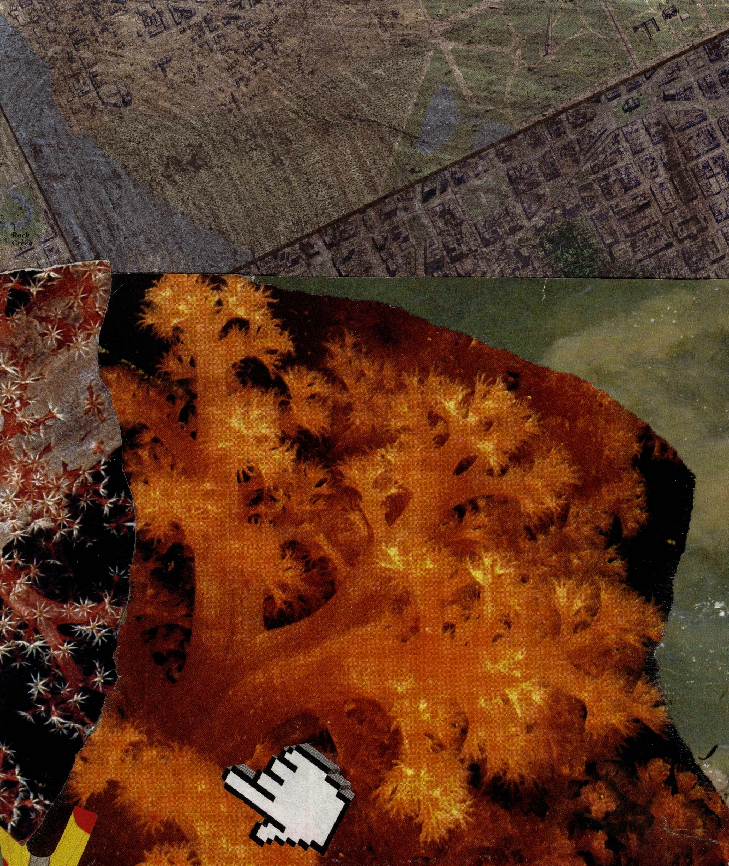
Nabeel Naveed
Wetland
Collage on Paper
15 cm x 10 cm
PKR 20,000

Slide 10
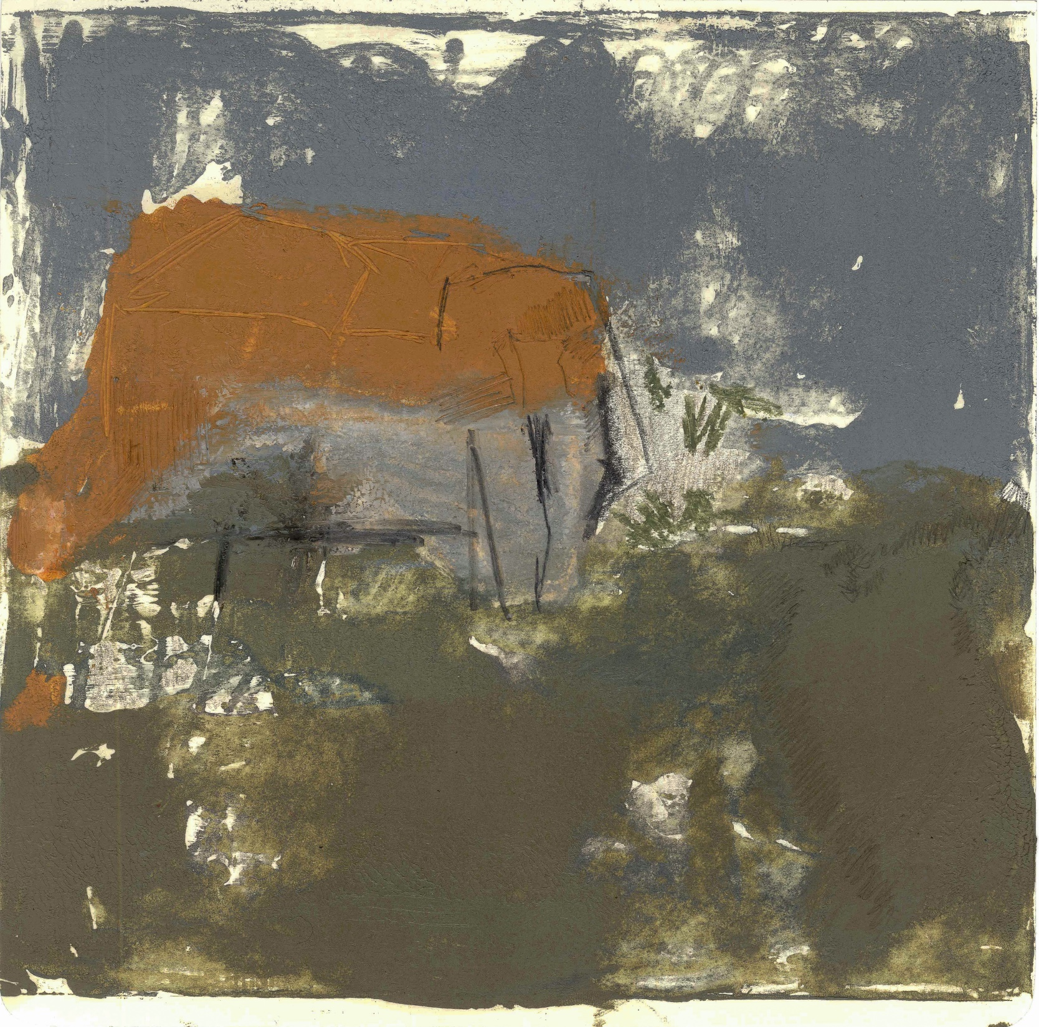
Nabeel Naveed
Coastal Belt
moleskin monotype
19 cm x 19 cm
PKR 20,000

Slide 11
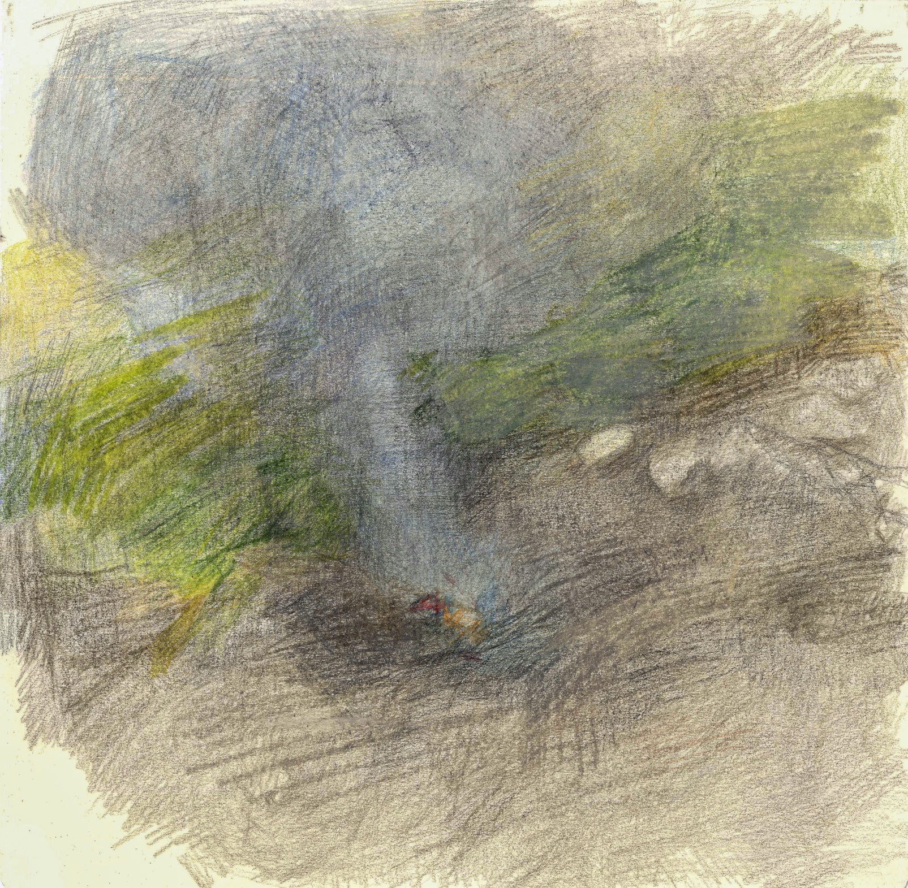
Nabeel Naveed
Sohni-Lath-Mukka-Bangla
led on Paper
19 cm x 19 cm
PKR 20,000

Slide 12
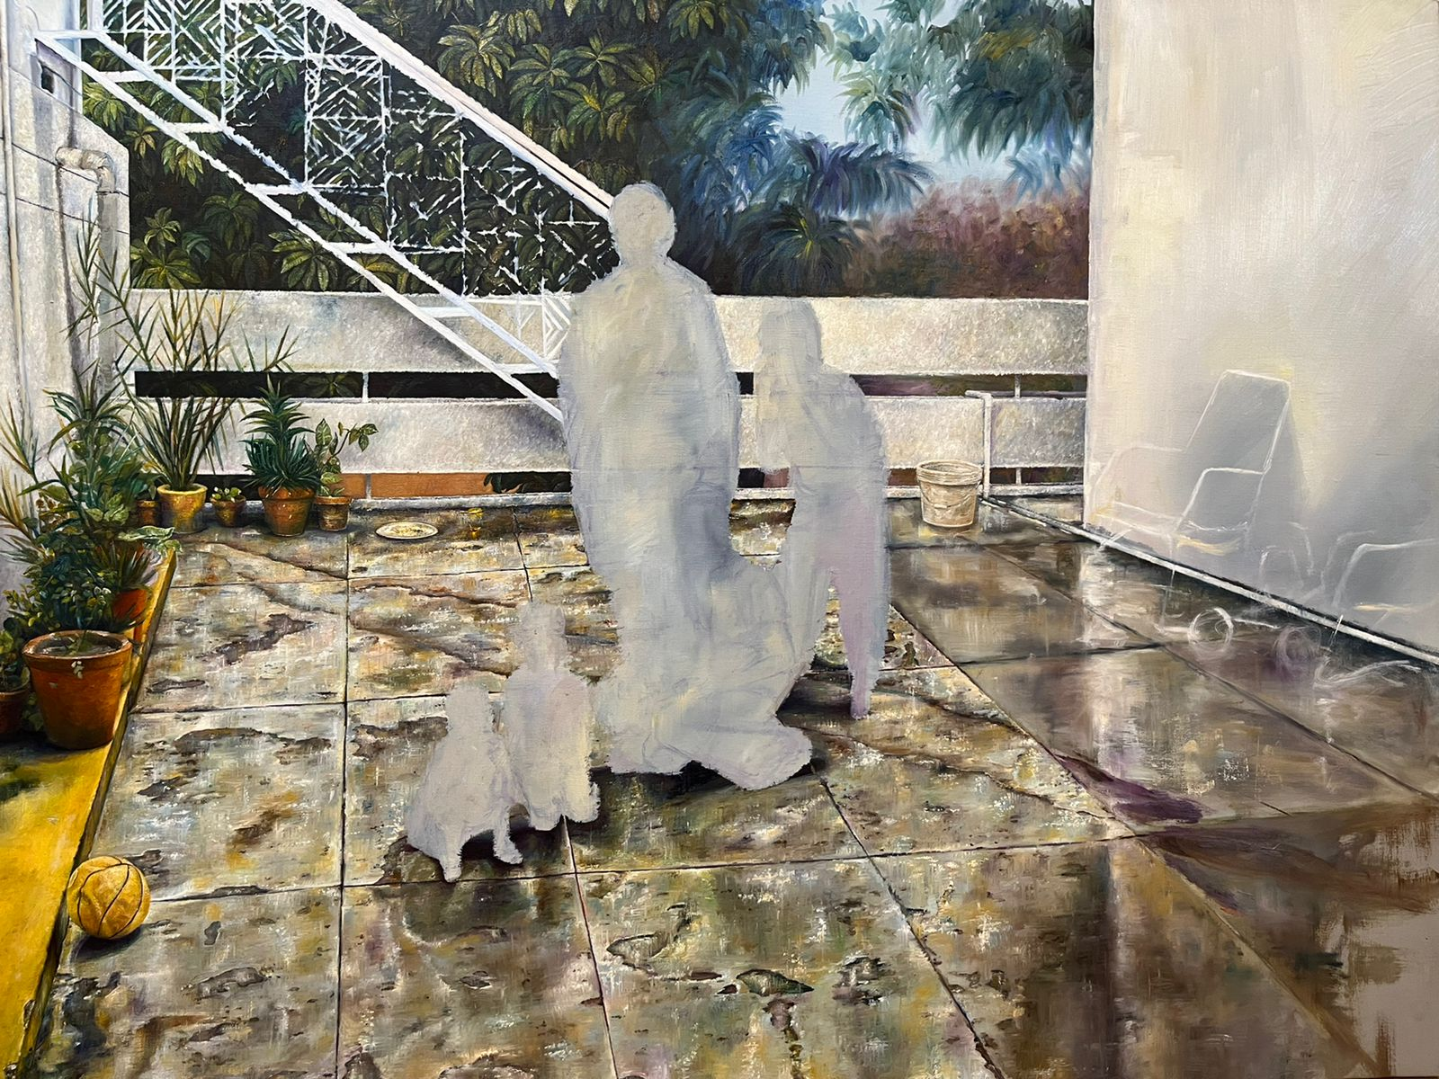
برسات اور آم
36x48 inches
Oil on Canvas
PKR 82,000
2021

Slide 13
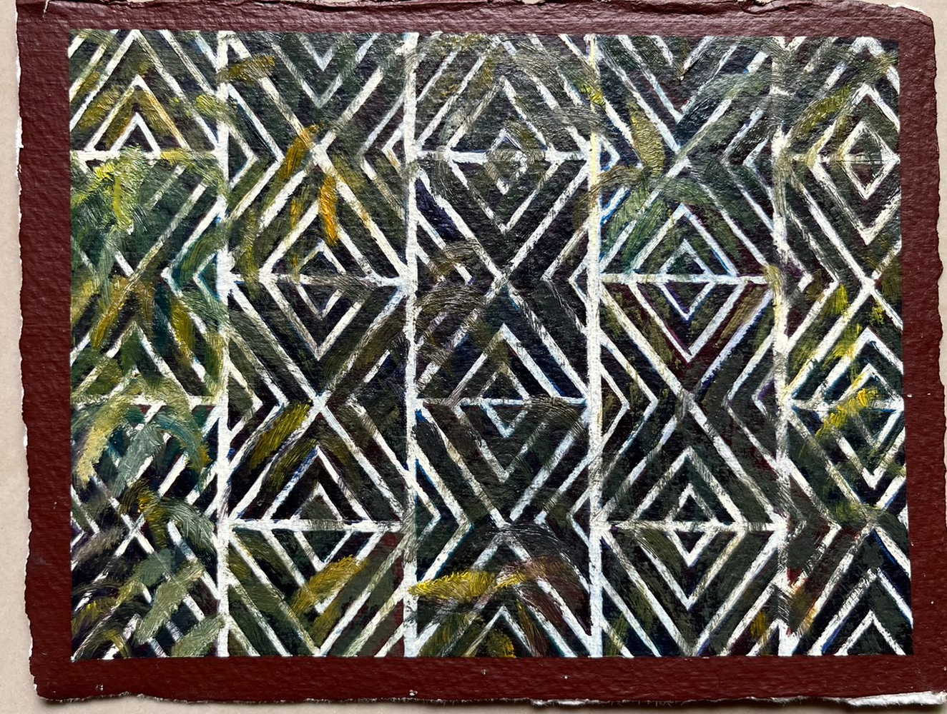
Hafsa Nouman
آم I
5.5x7.5 inches
Oil on Archival paper
PKR 22,000
2022

Slide 14
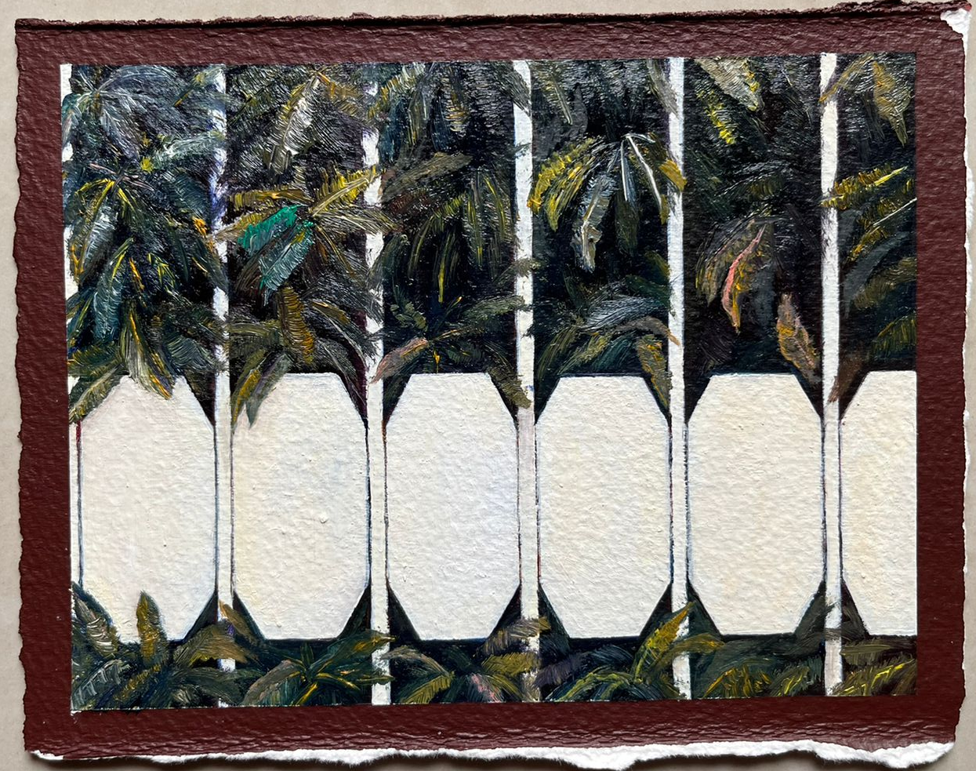
Hafsa Nouman
آم II
5.5x7.5 inches
Oil on Archival paper
PKR 22,000
2022

Slide 15
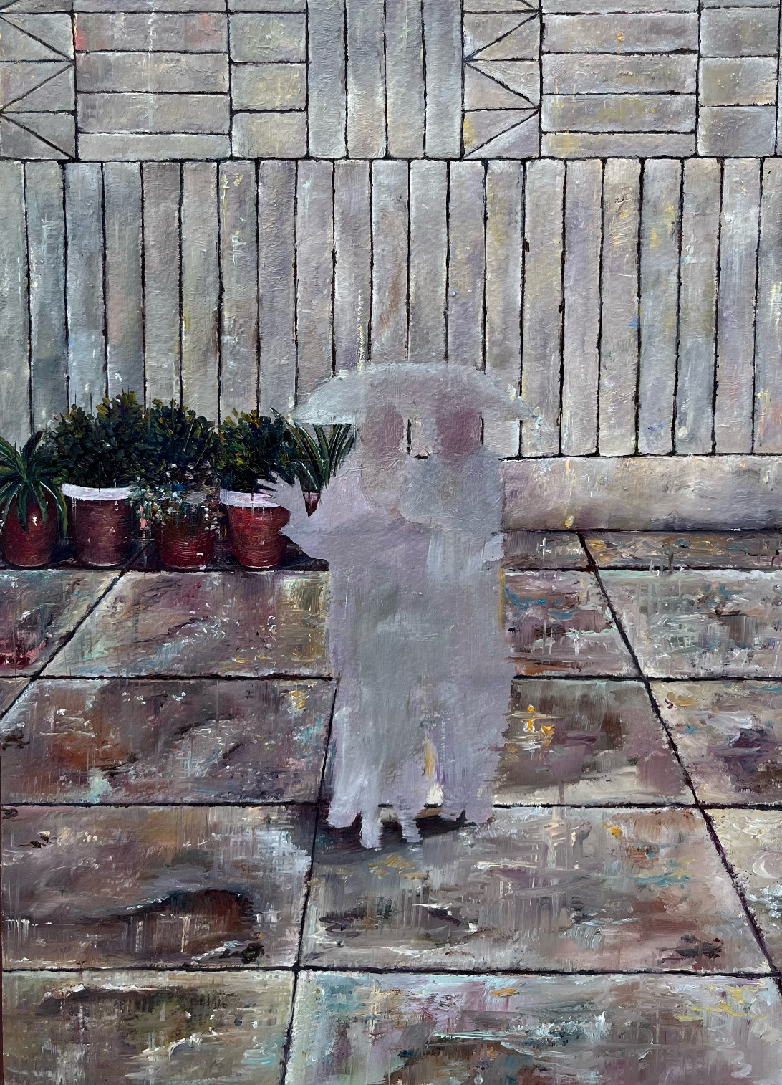
Hafsa Nouman
بارش میں نہانا
15.5x11.5 inches
Oil on Archival paper
PKR 48,000
2022

Slide 16
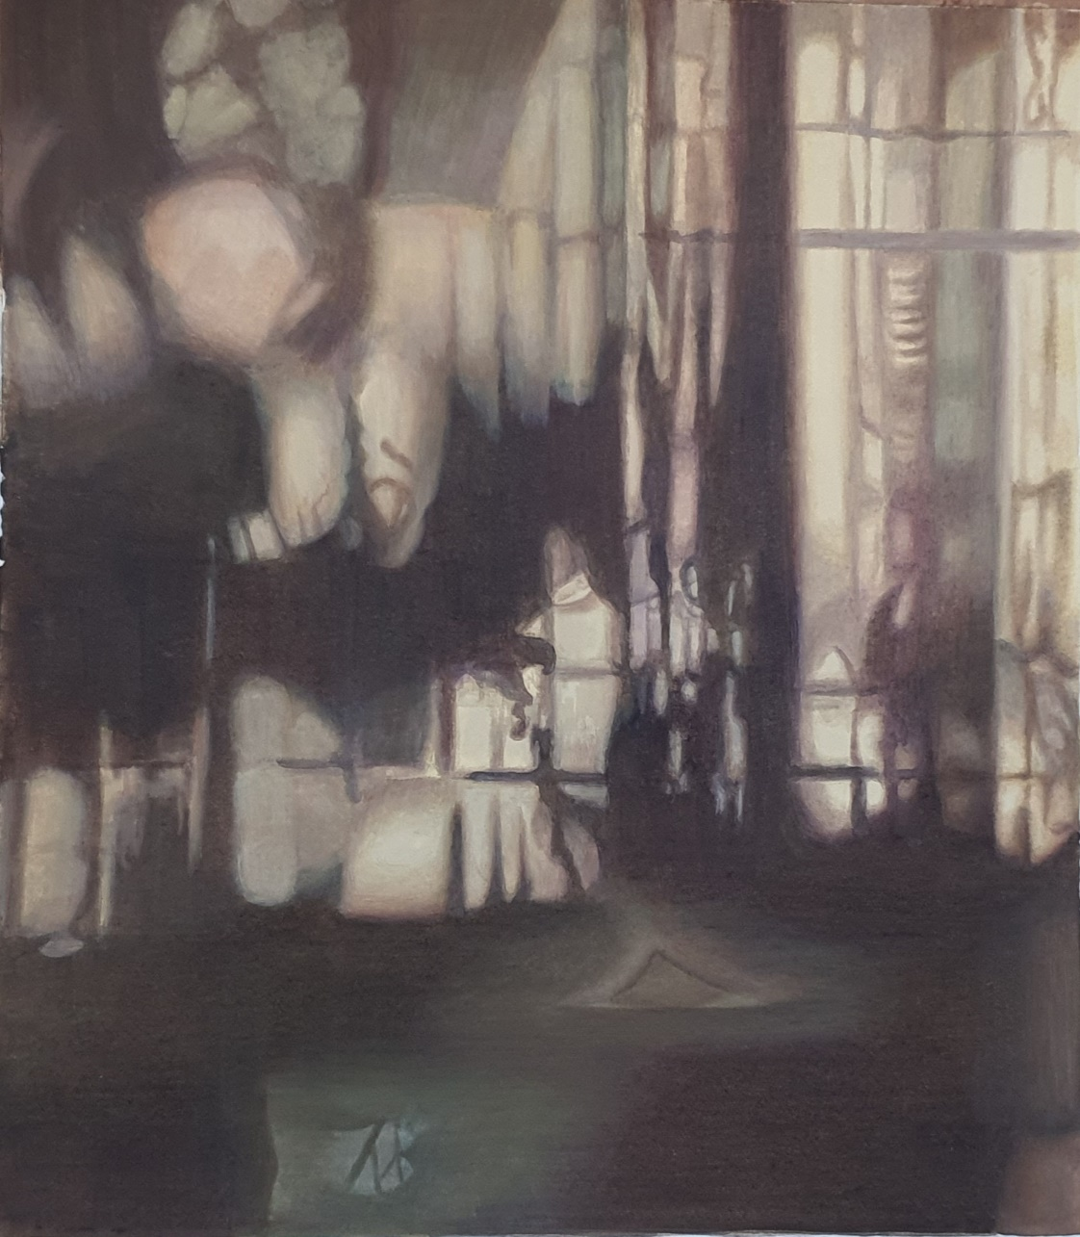
Momina Javed
I سائے
Gouache on Wasli 15.6x17.1 inches PKR 42,000 2022

Slide 17
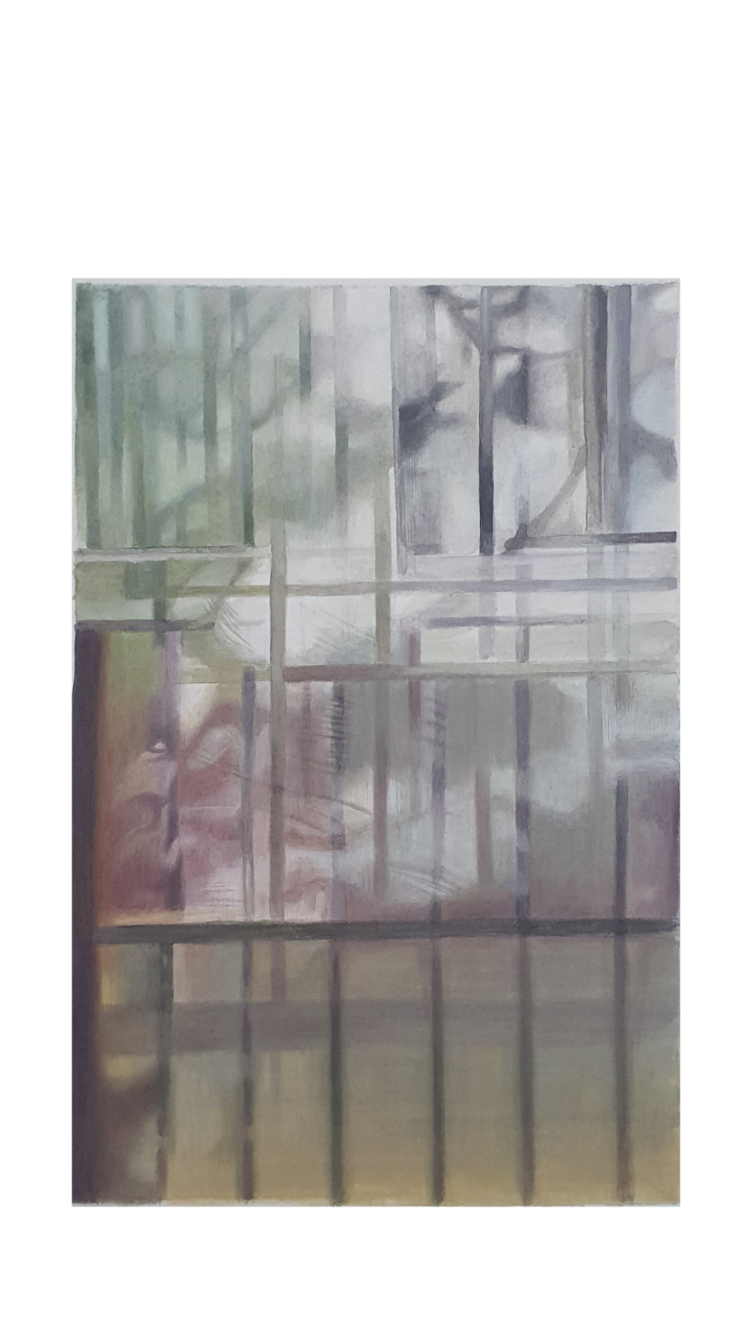
Momina Javed
II سائے Gouache on Wasli 14.6x11.6 inches PKR 38,000 2022

